Slide 1
Mapping the Past: Using Historical Maps and Aerials to Uncover South Florida’s Past

Slide 2
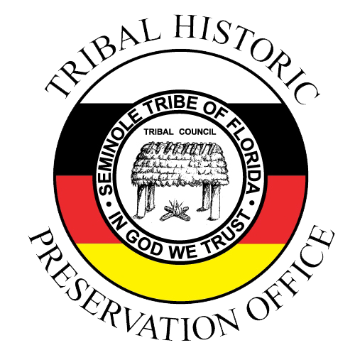
What is STOF-THPO?
Our Mission Statement
To foster the understanding and appreciation of the Tribe's place in humanity's shared heritage by investigating, interpreting, preserving and managing the Tribe's cultural resources through community engagement
Our Vision Statement
To excel at supporting the Tribe in sustaining its cultural and historic resources

Slide 3
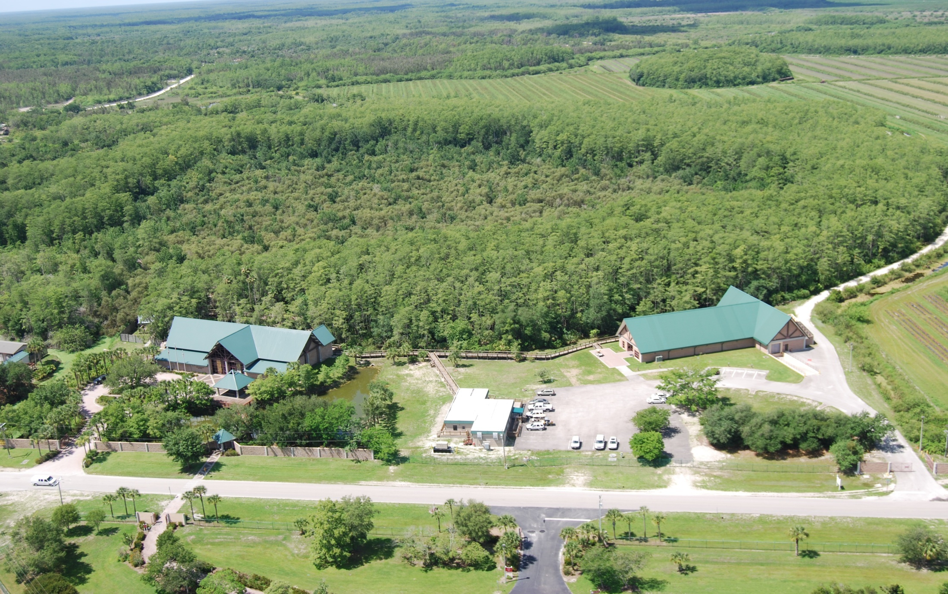
THPO Sections:
Administration
Archaeometry
Collections
Compliance
Tribal Archaeology

Slide 4
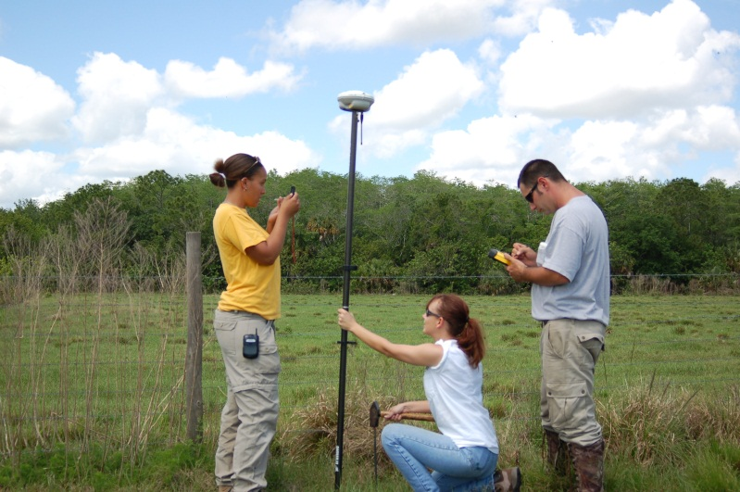
Archaeometry
Database Design
Geographic Information Systems (GIS)
Mobile GIS
Non-Invasive Geospatial Analysis Techniques

Slide 5
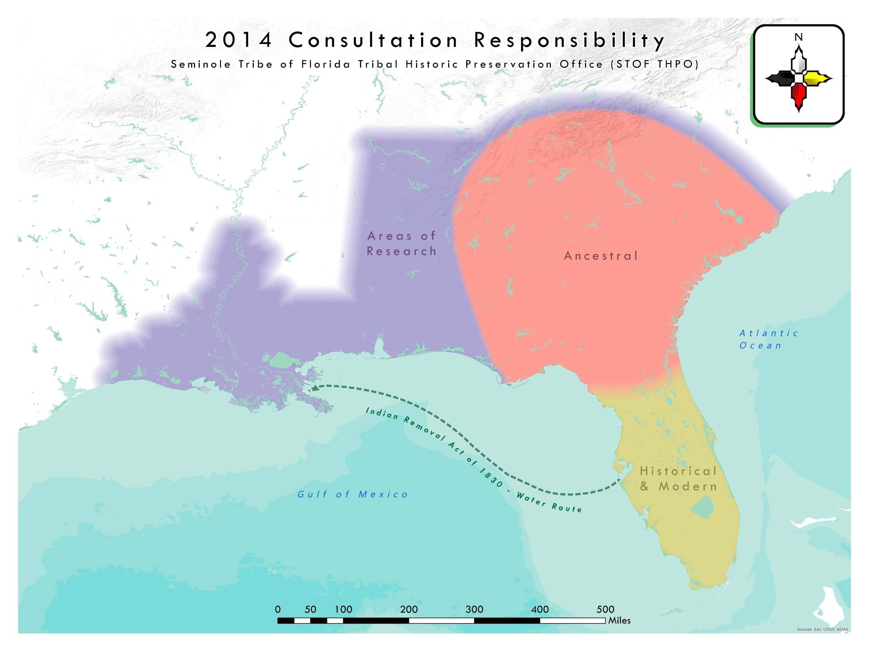
Compliance Section:
Section 106 of NHPA
ARPA
NAGPRA

Slide 6
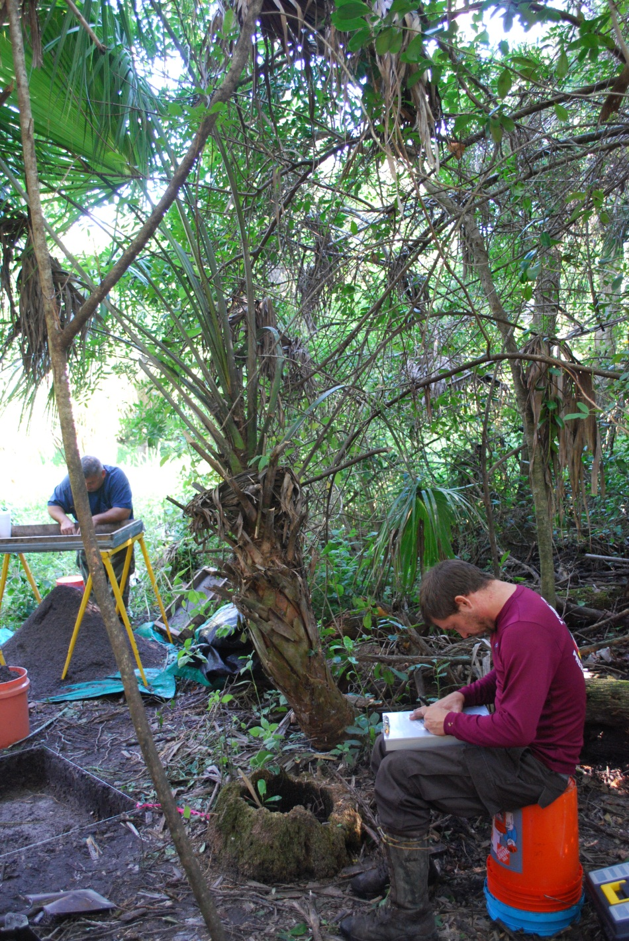
Tribal Archaeology
423 on-reservation archaeological sites
In 2014, TAS conducted 124 project surveys covering a total of 1,905 acres

Slide 7
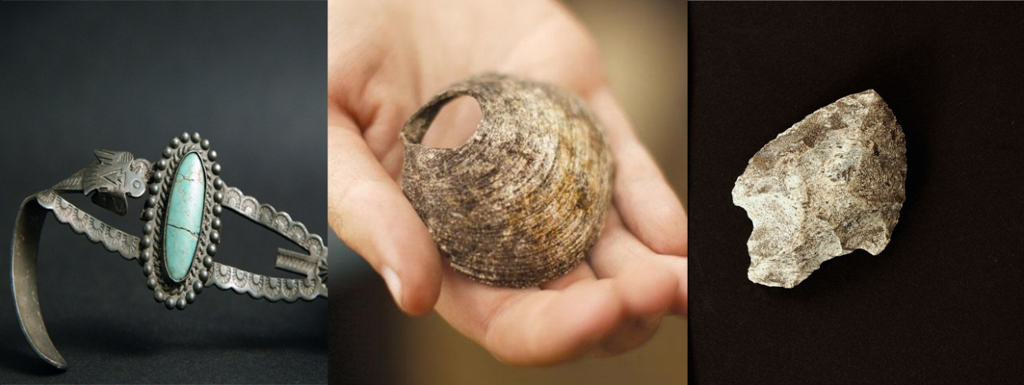
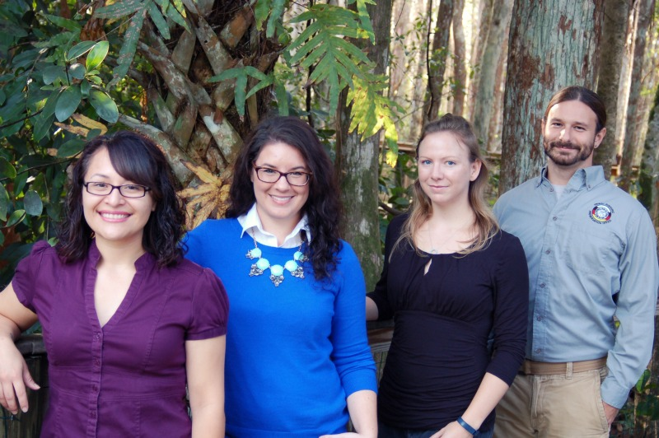
Collections Section
Staff:
Kate Macuen – Collections Manager
Patty Rodriguez – Lab Assistant
Domonique DeBeaubien – Bioarcheologist
David Brownell – Research Assistant

Slide 8
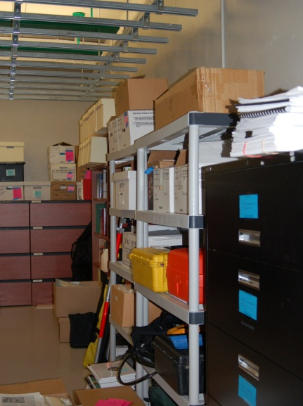
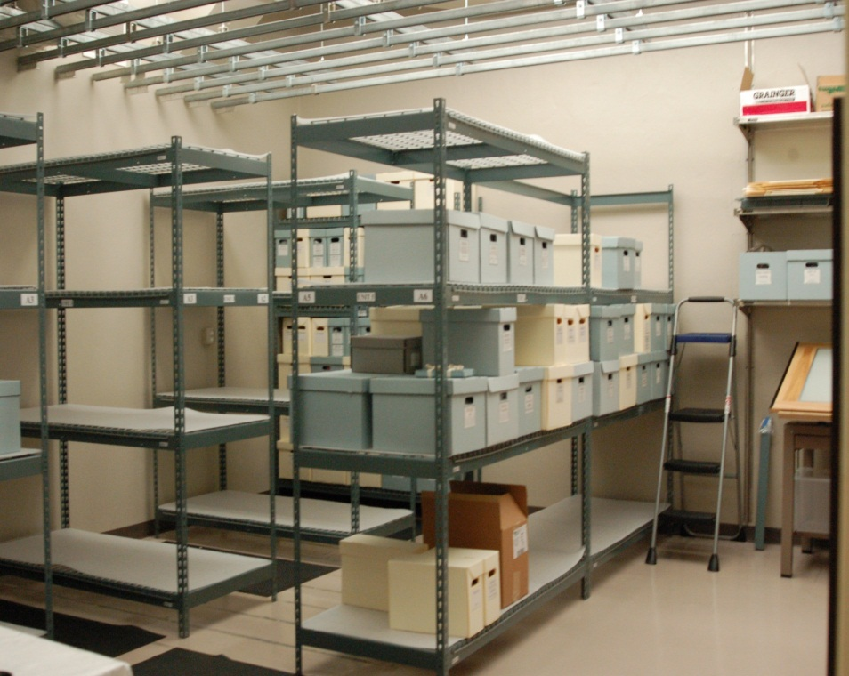
Collections
Archaeological Artifacts
Archaeological Reports
Cemetery Records
Gallagher Photos
Seminole Site File

Slide 9
Tribal History Mapping Projects!

Slide 10
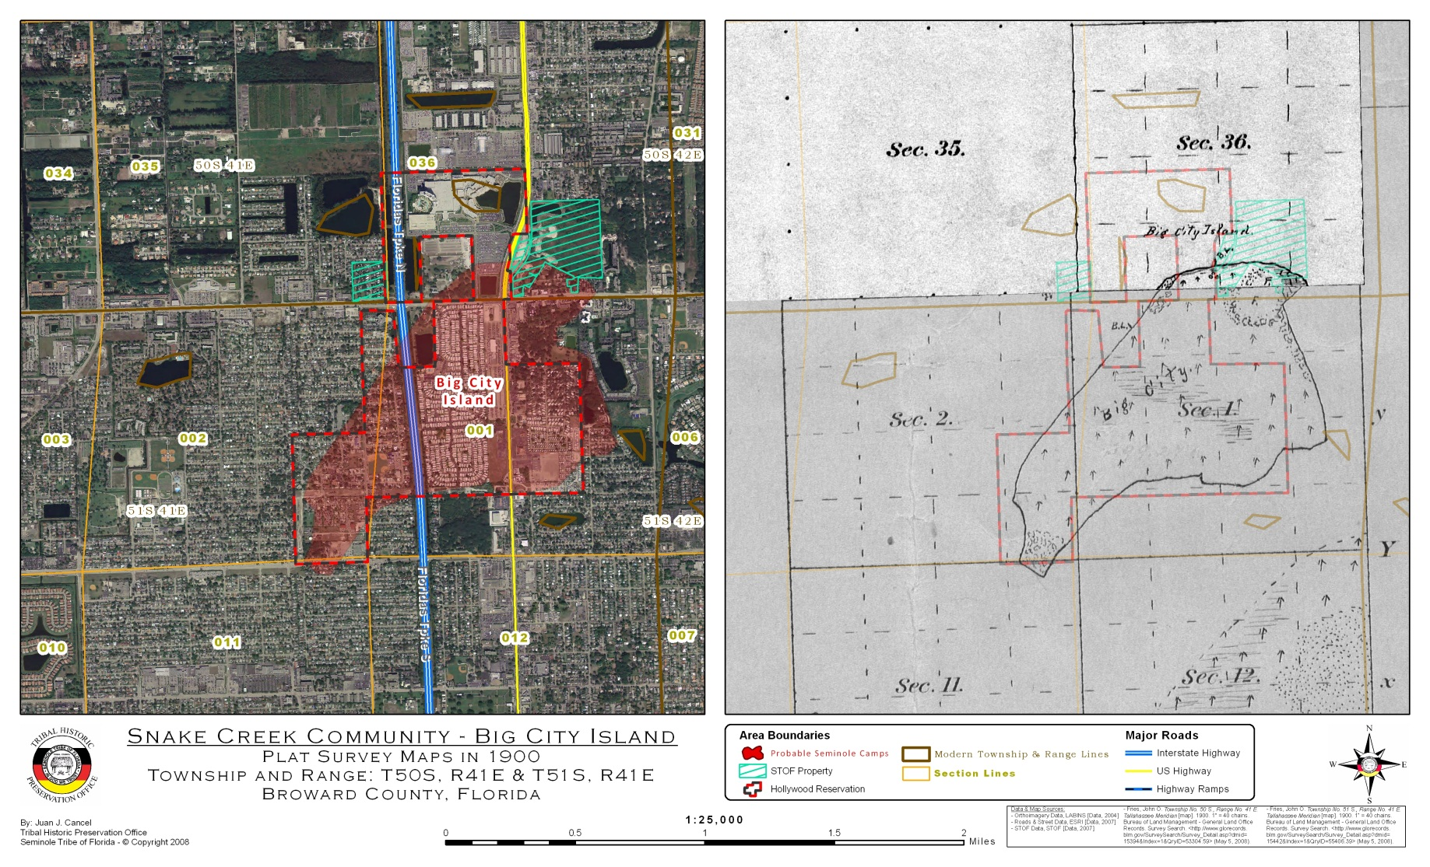
Big City Island Federal Land Trust Application

Slide 11
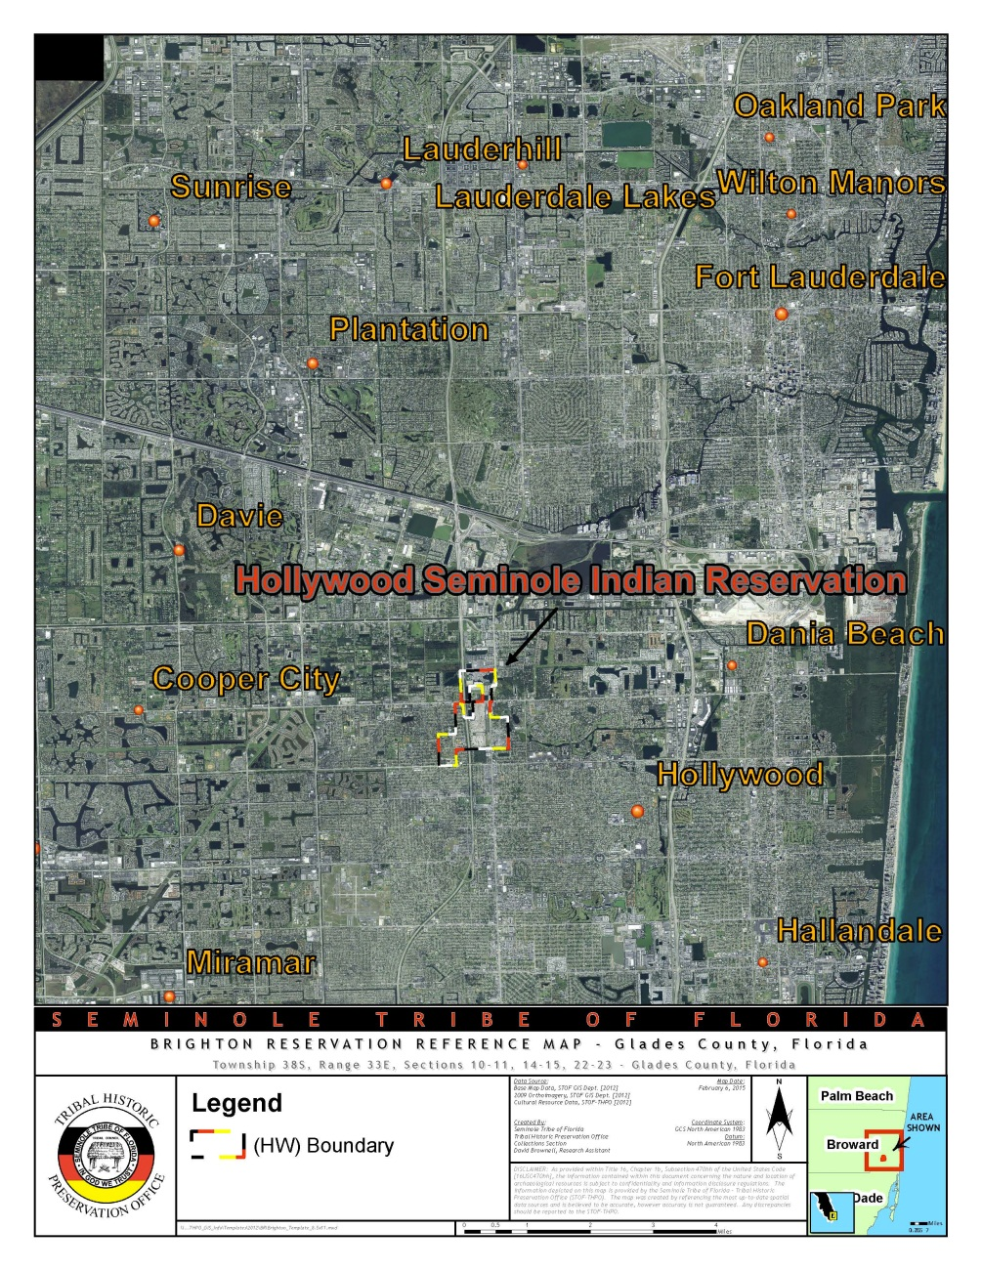
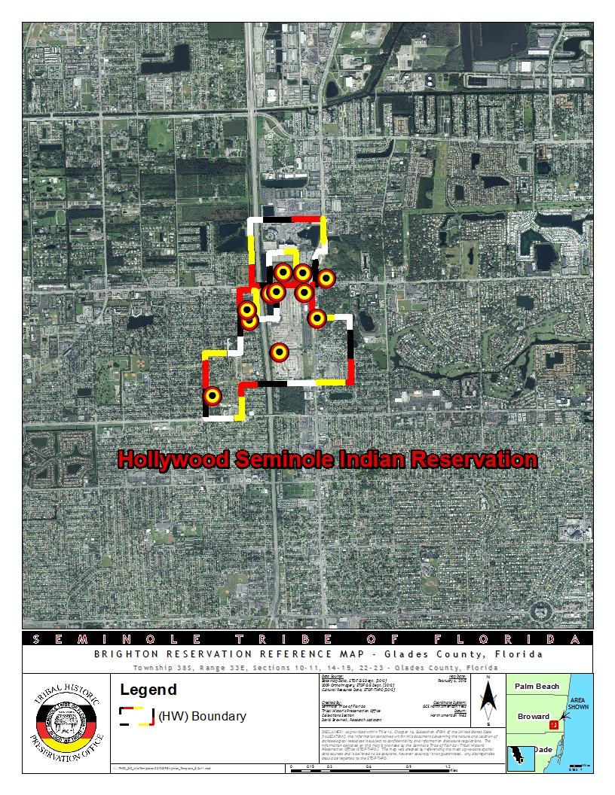
Hollywood Seminole Indian Reservation

Slide 12
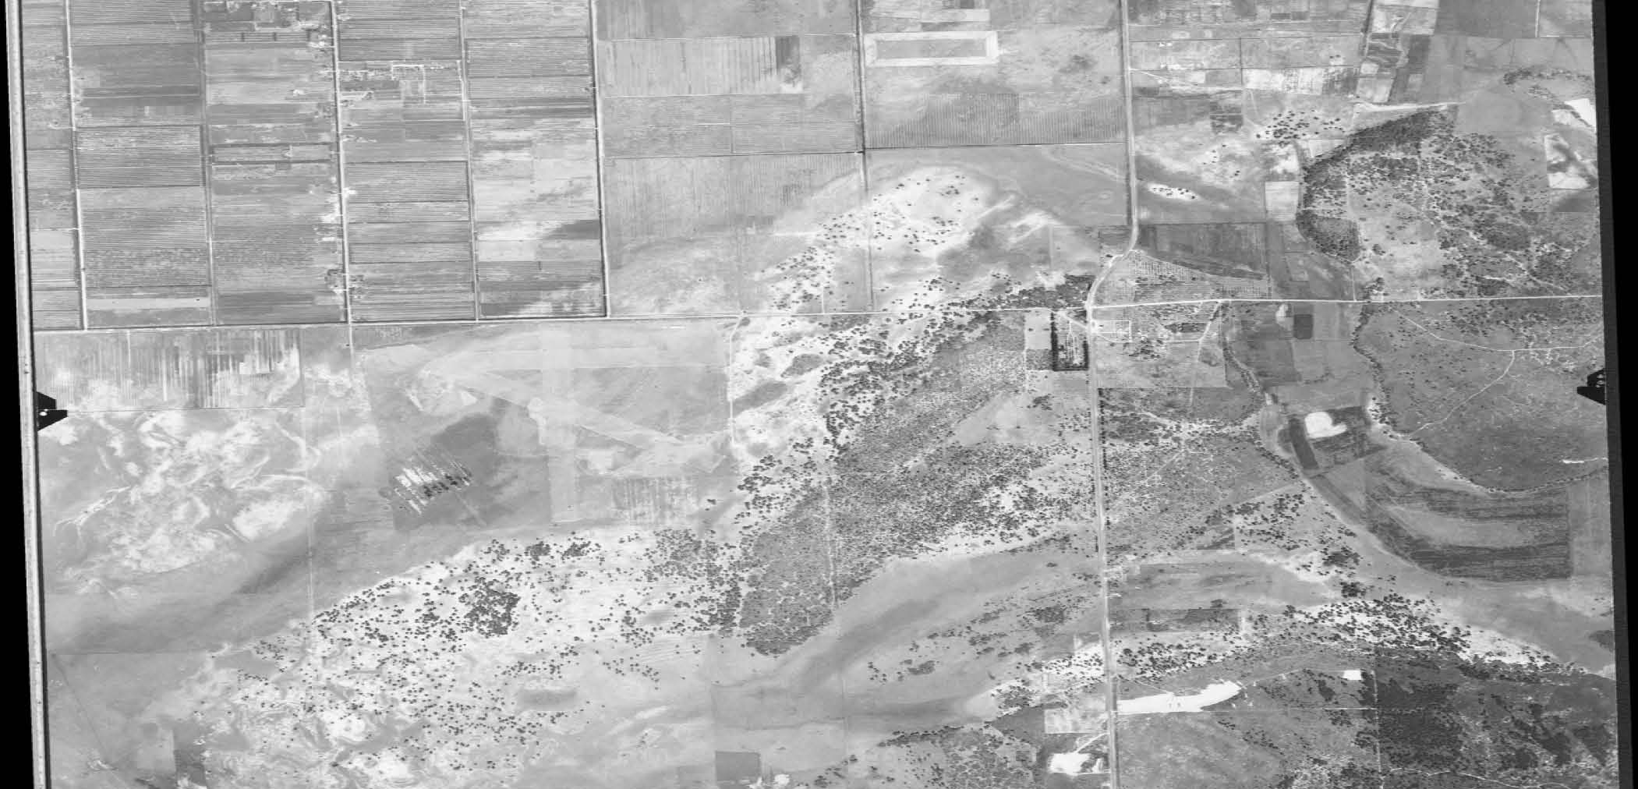
Big City Island, circa 1940
USDA Flight Code CJF, 1940

Slide 13
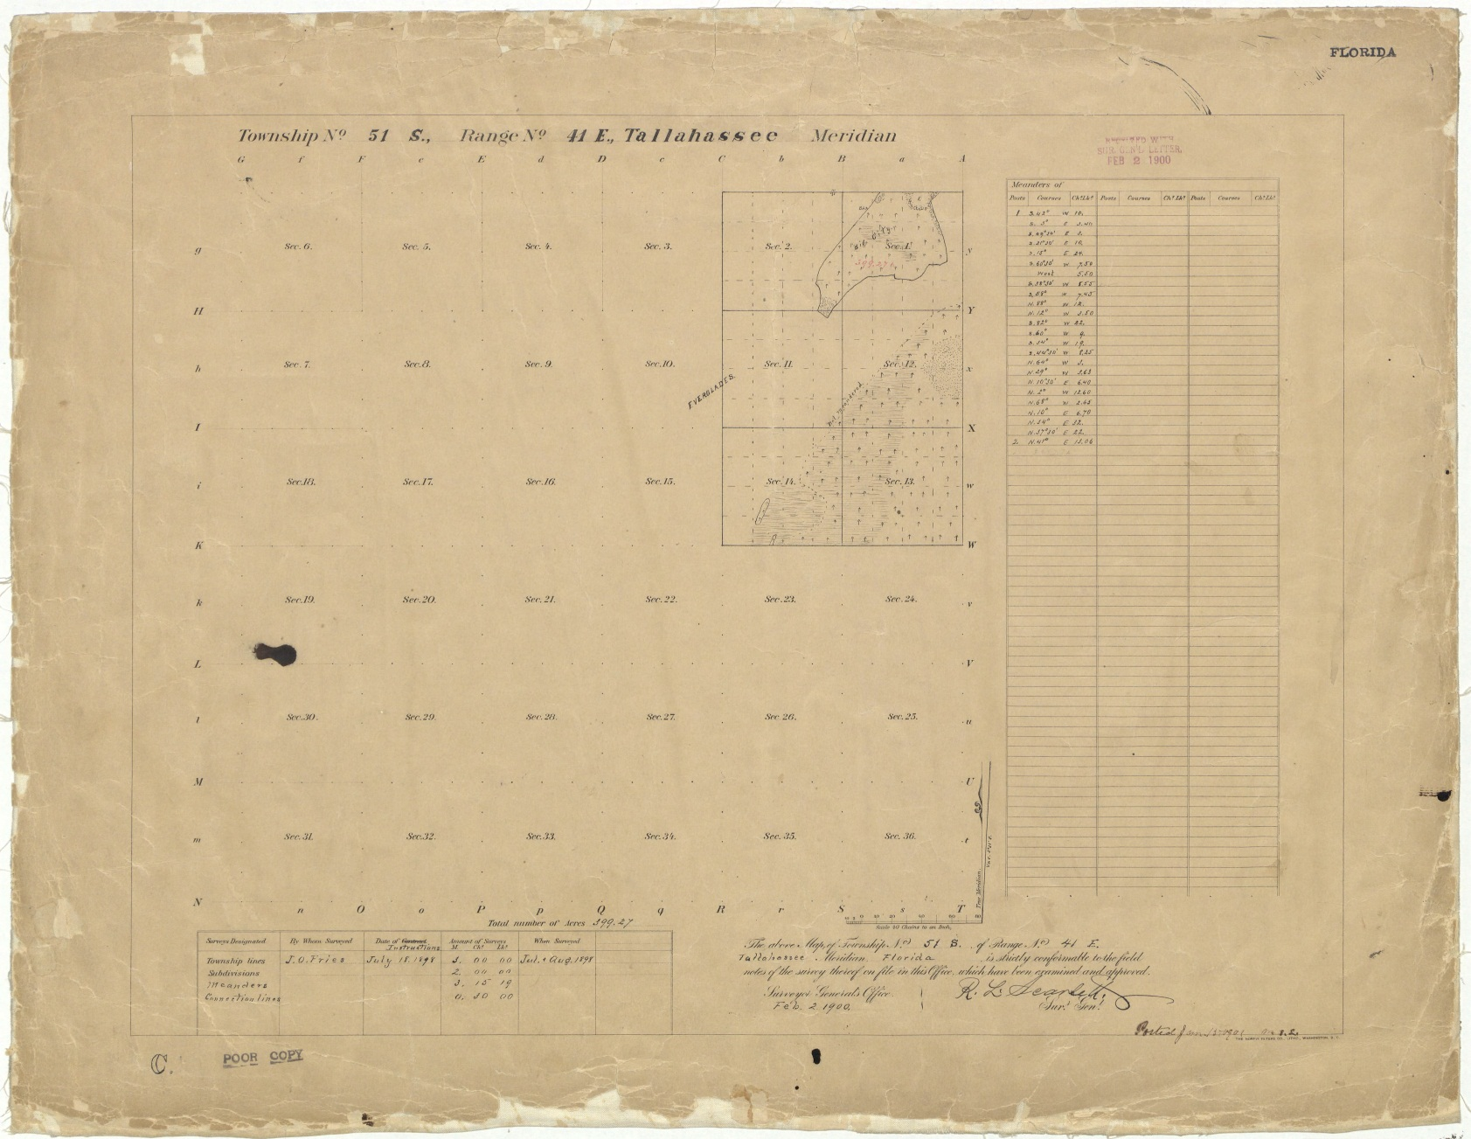
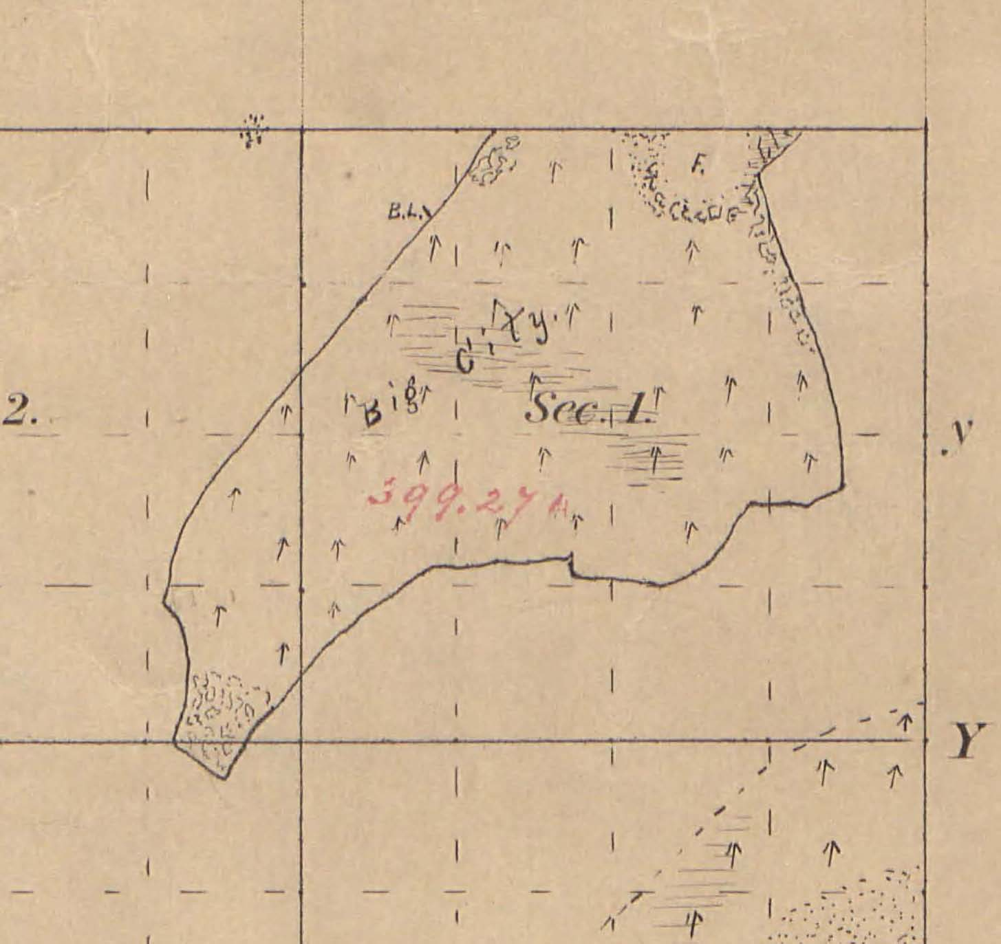
J.O. Fries’ 1898 Topographical Plat

Slide 14
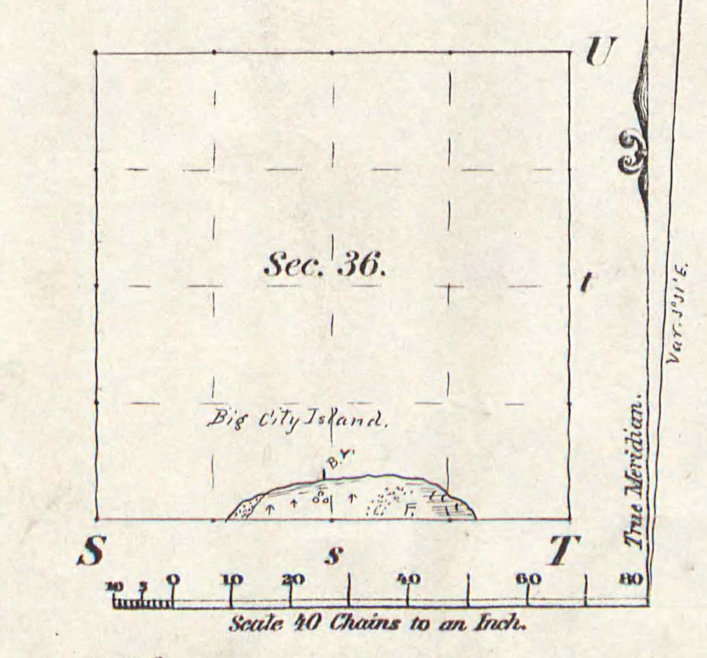
J.O. Fries’ 1898 Topographical Plat

Slide 16
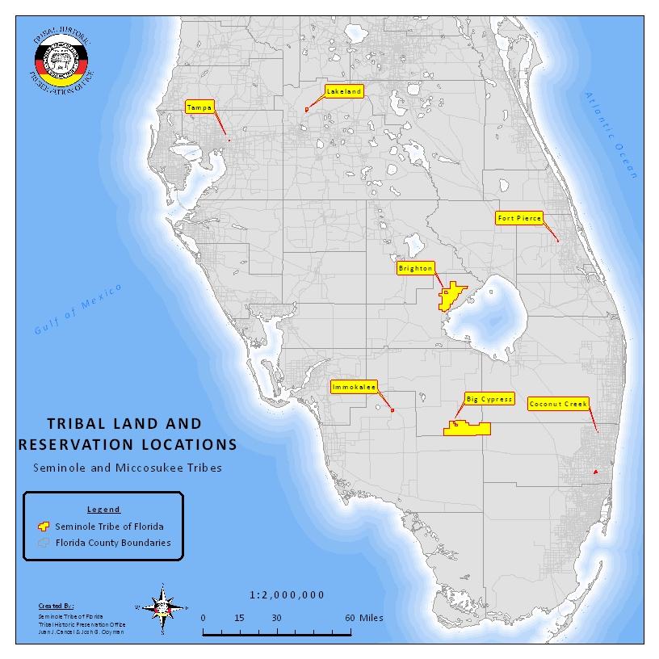
Immokalee Reservation
Land Trust Application
& Oral History Project

Slide 17
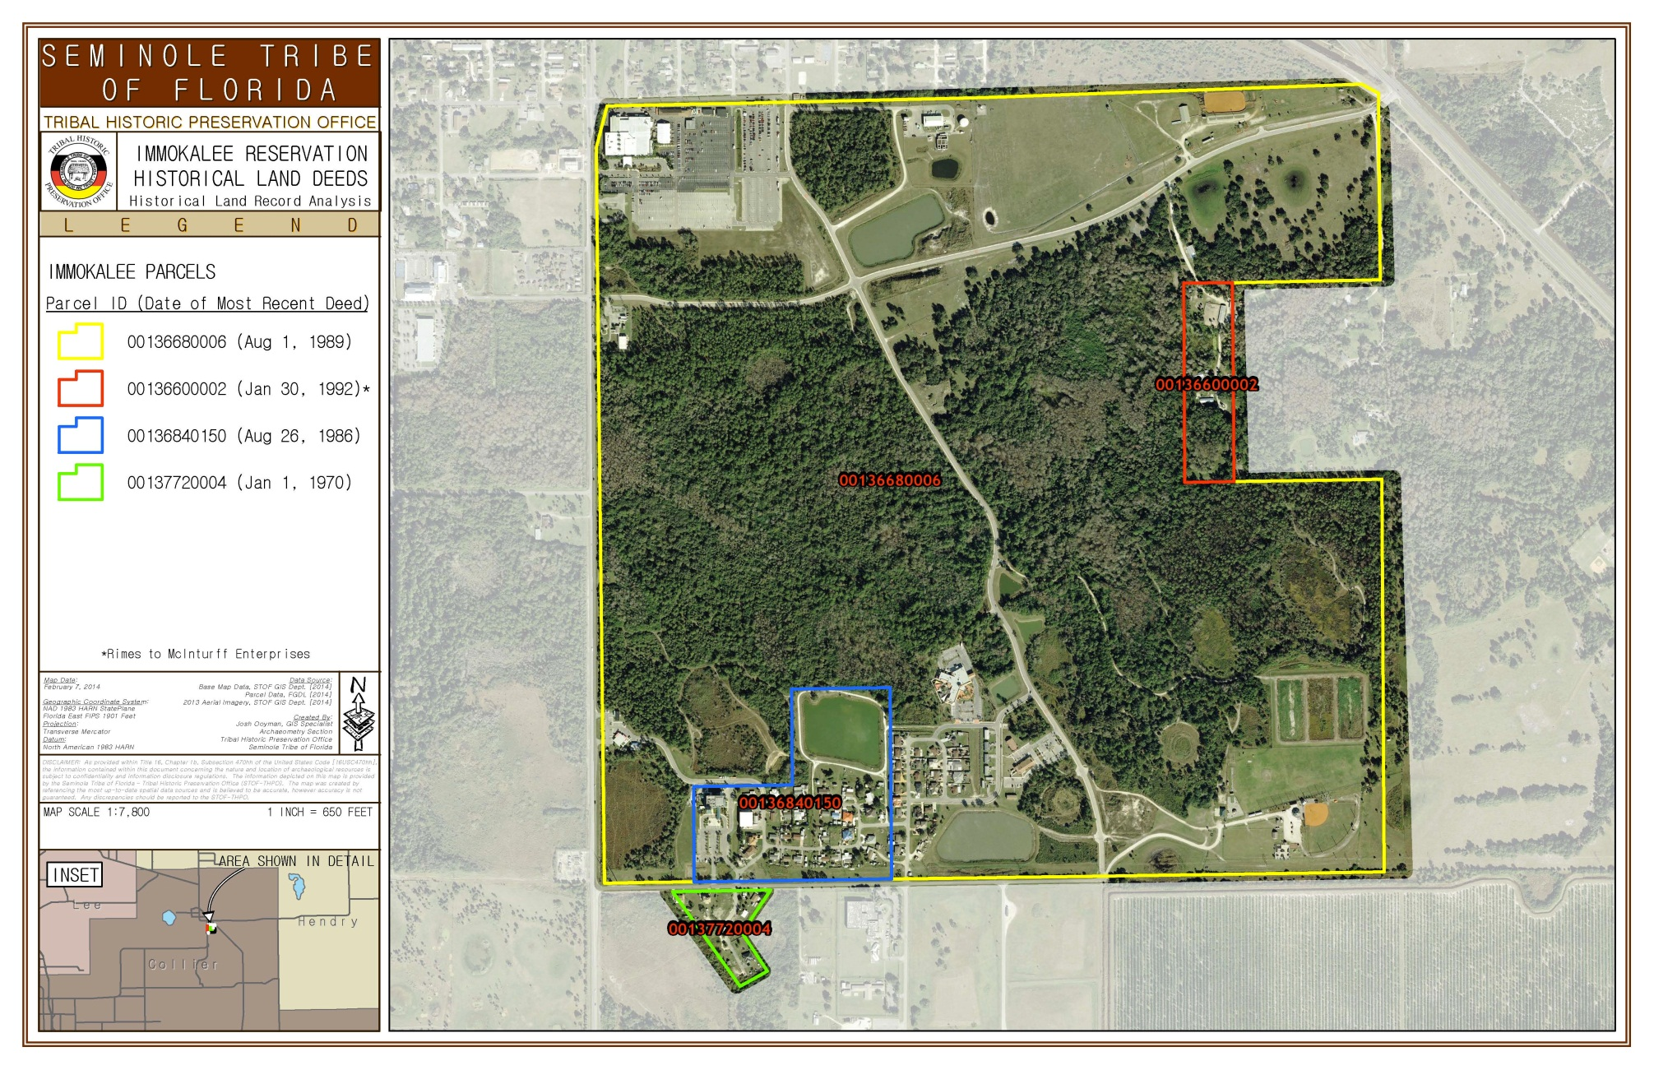

Slide 18
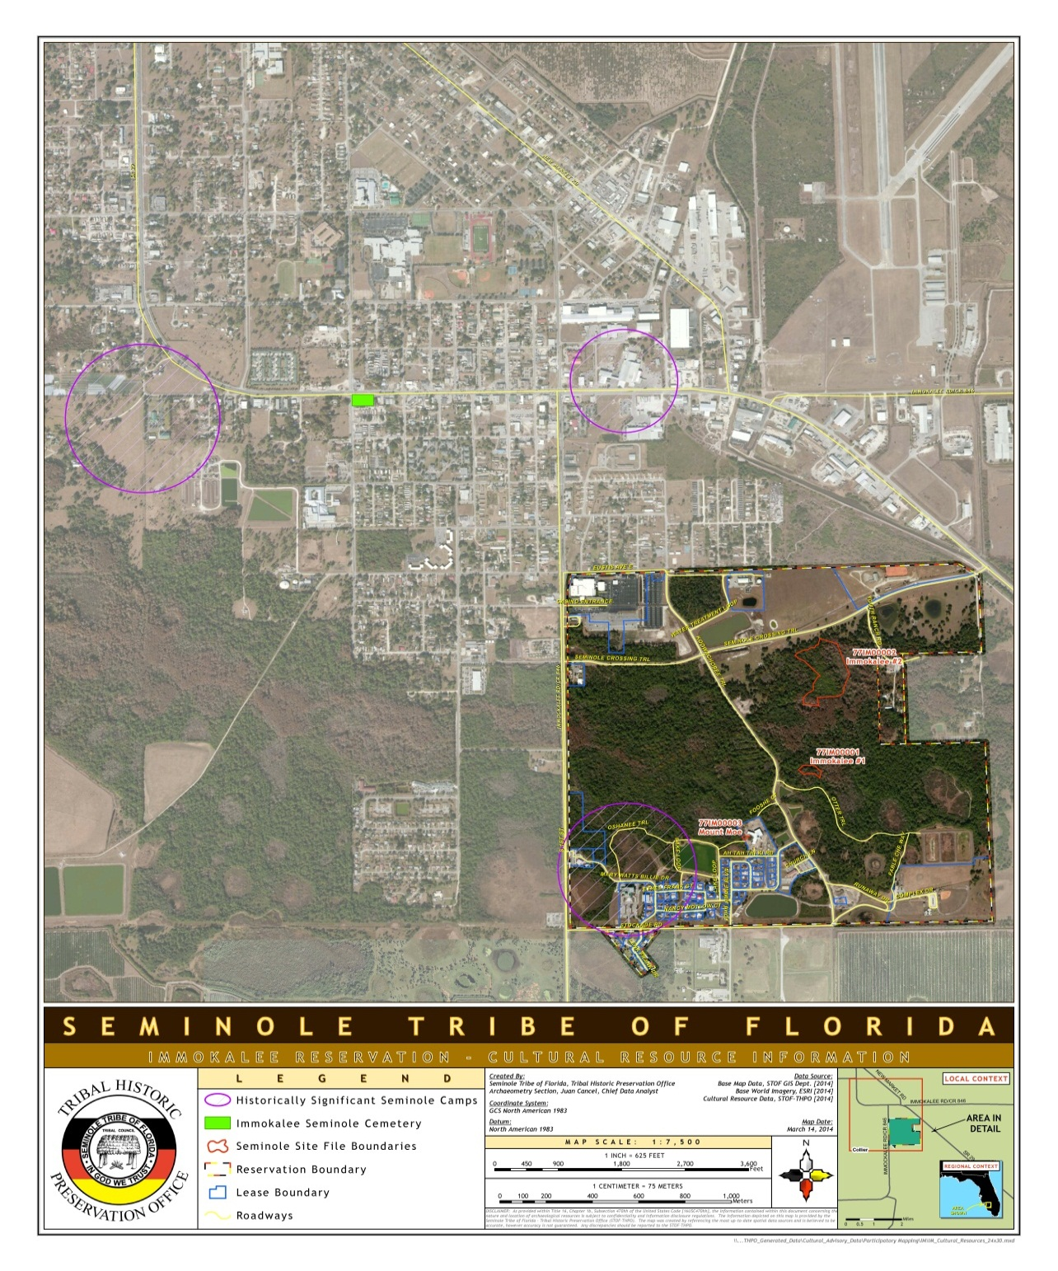

Slide 19
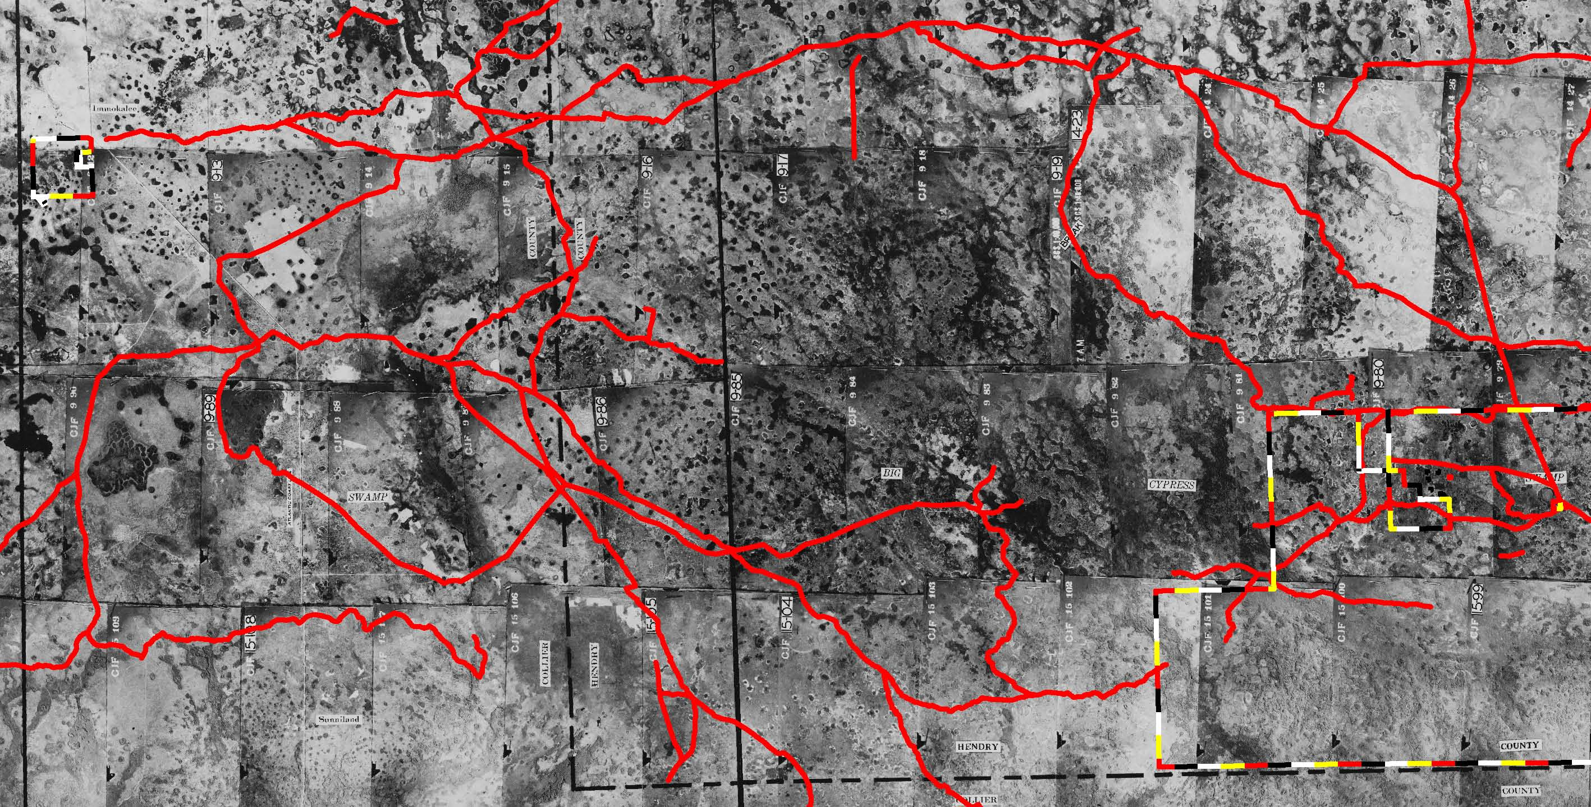
Big Cypress and Immokalee Trails
USDA Flight Code CJF, 1940

Slide 20
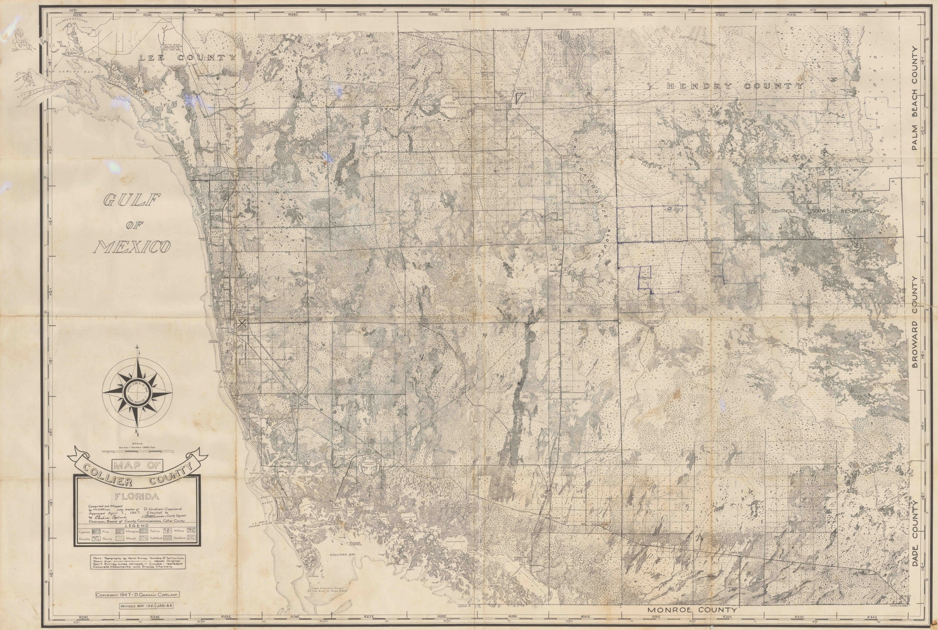
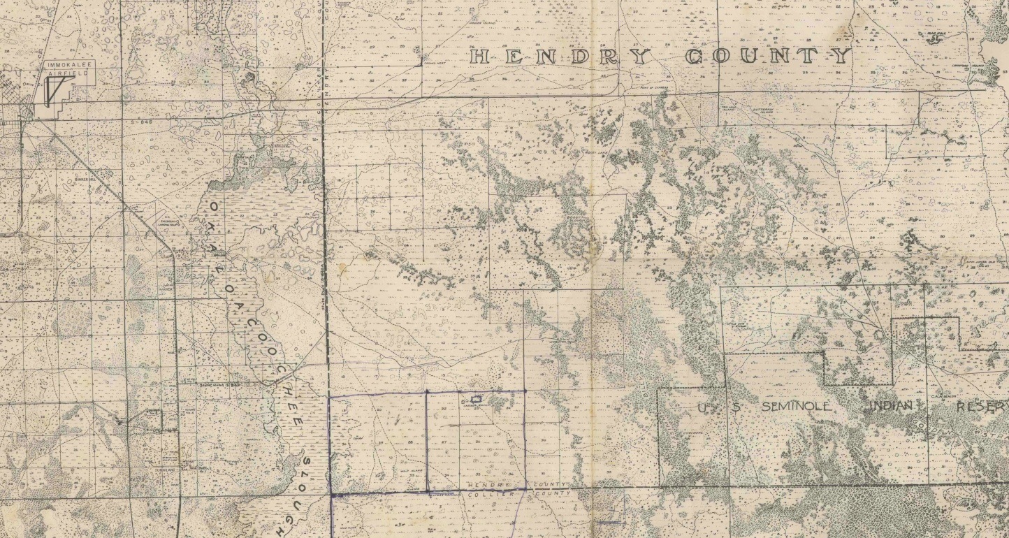

Slide 23
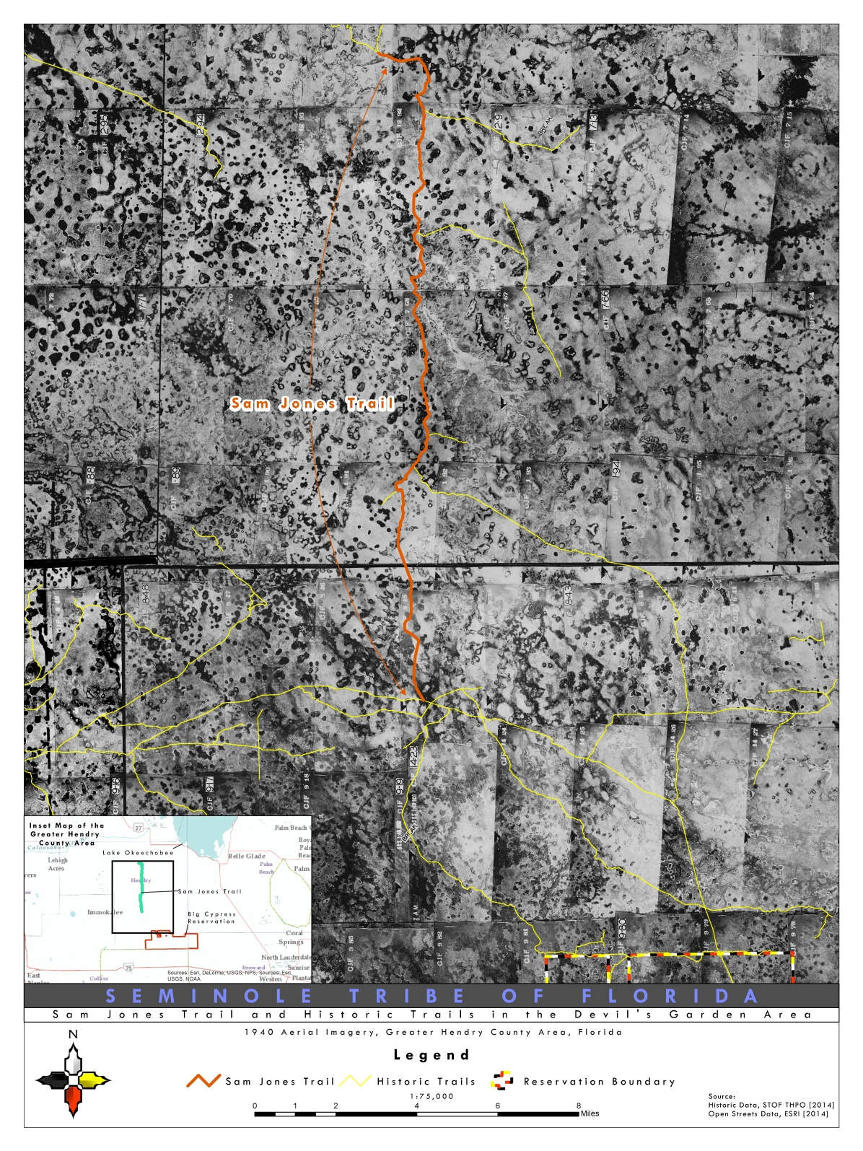
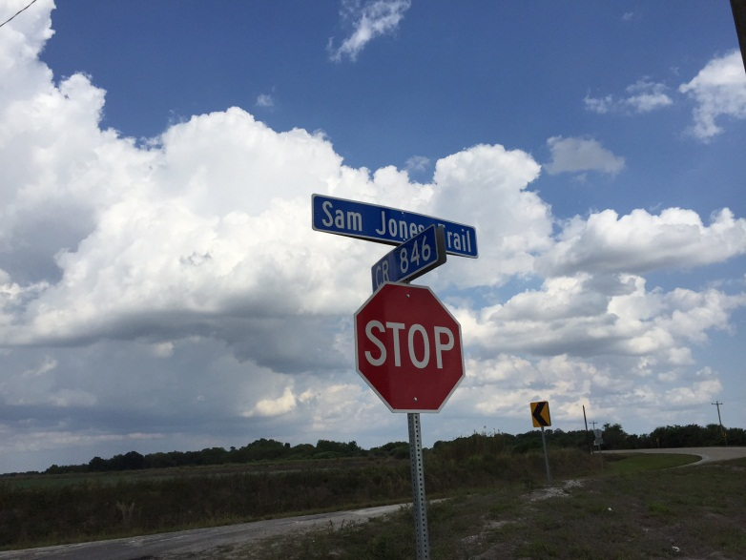
“Sam Jones Trail”
Hendry CR. 833 Designation

Slide 24
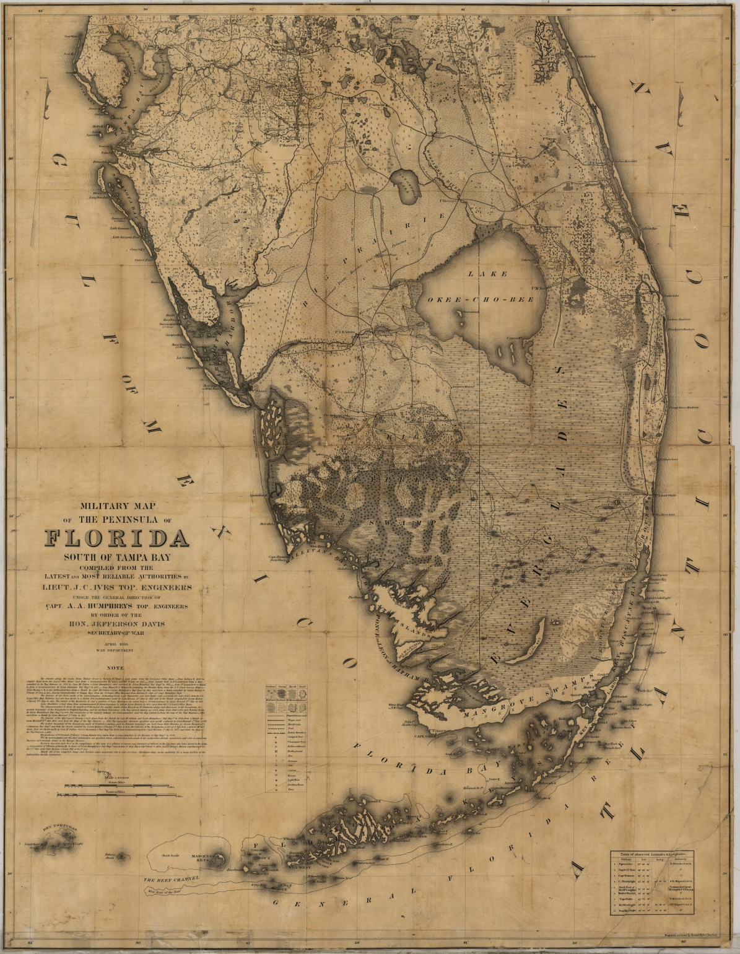
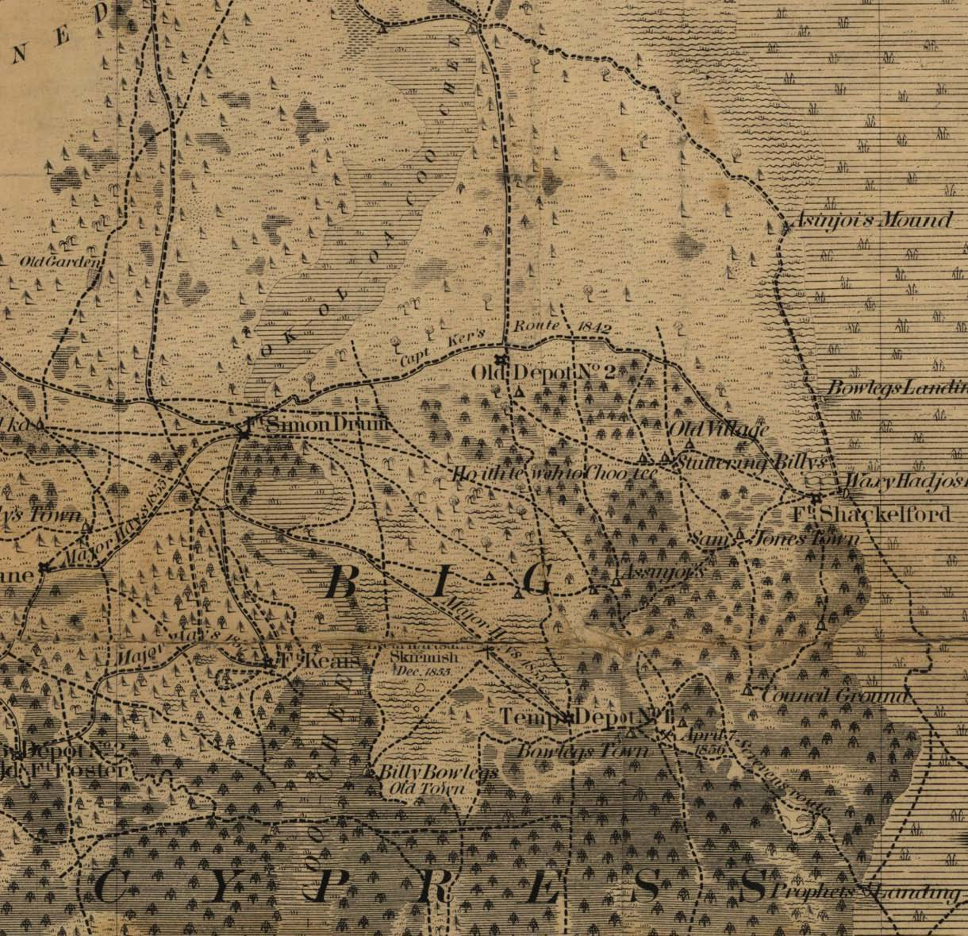

Slide 25
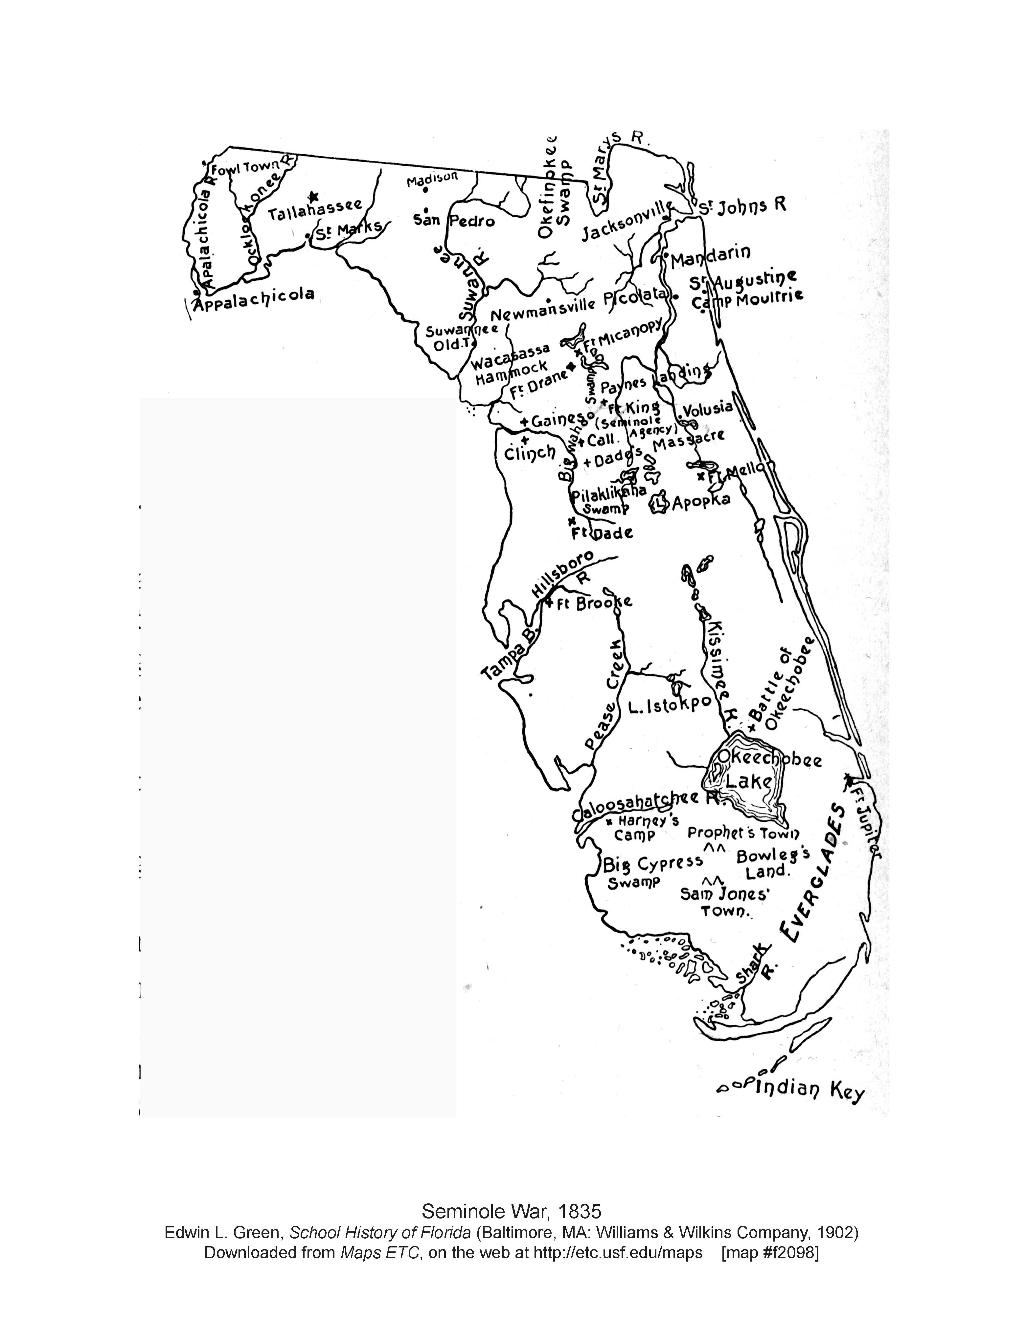
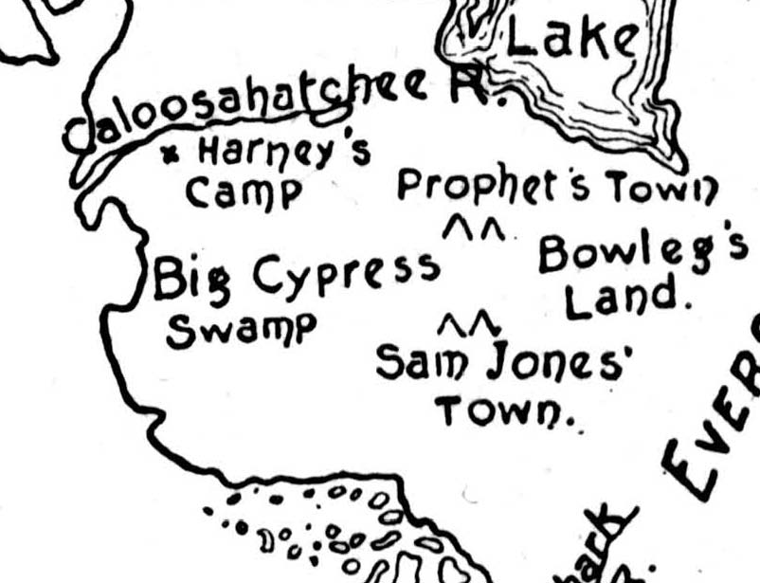

Slide 26
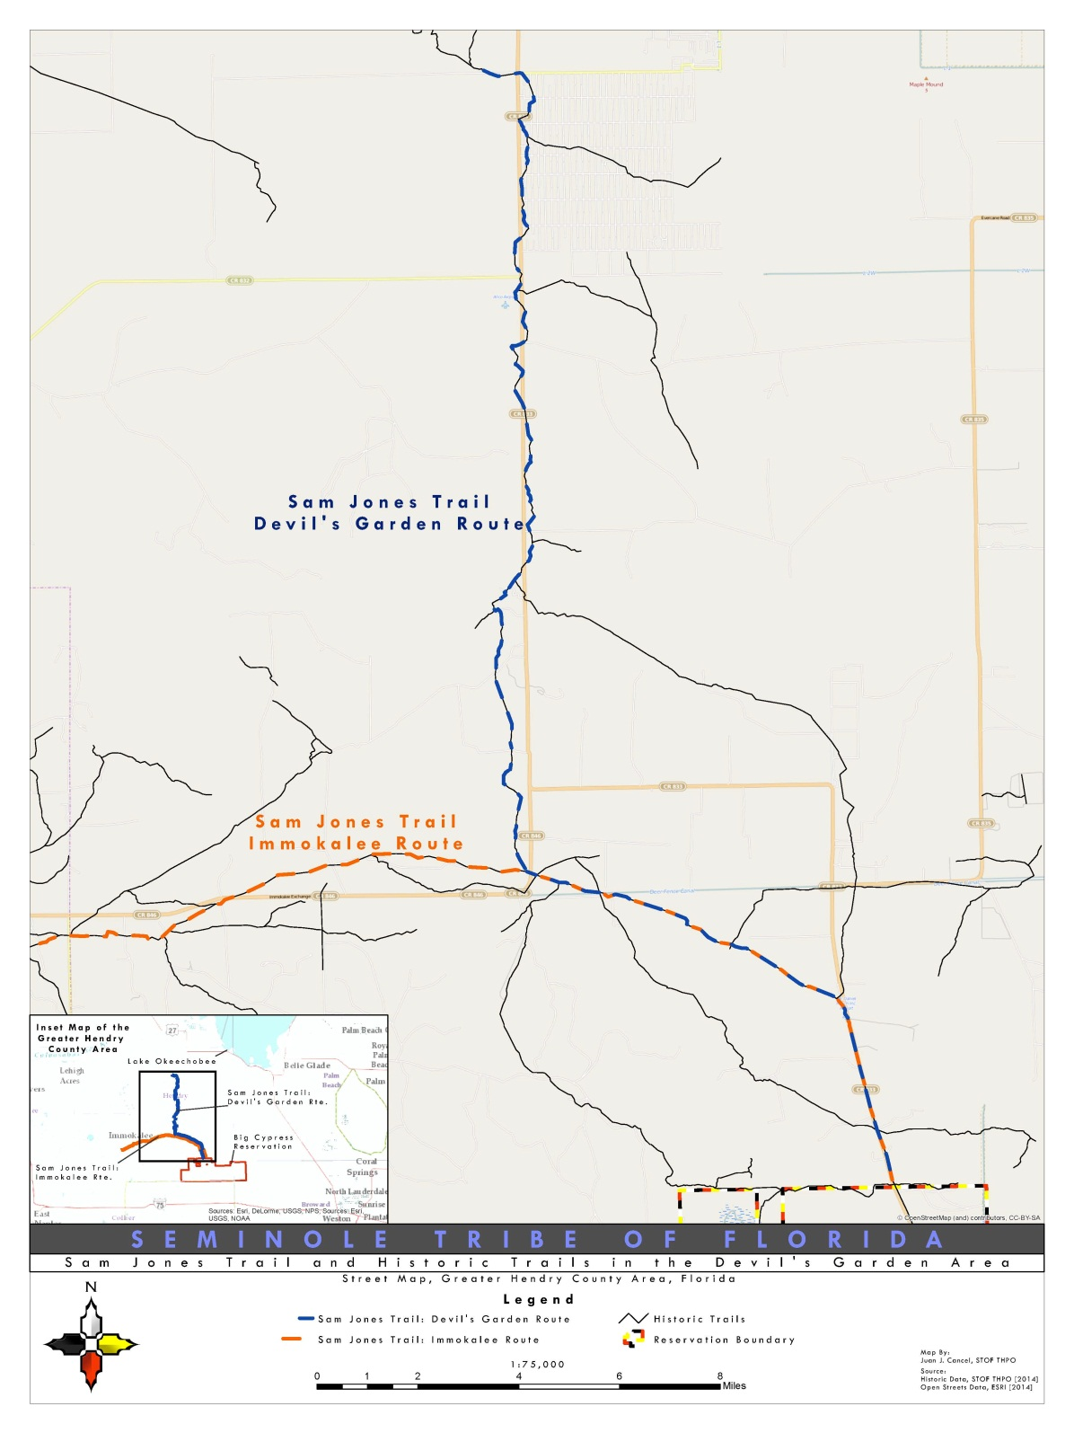

Slide 27
