Slide 1
Processing Architectural Collections
John Nemmers
Society of Florida Archivists Annual Meeting
Miami, May 2015

Slide 2
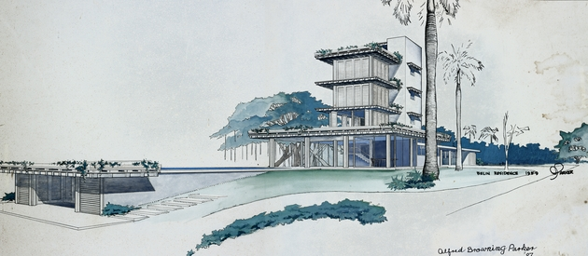
Always Ask for Funds!
Architectural records are great but they…
need lots of space
often require preservation/imaging
often are complicated to process = more labor
need more expensive storage supplies
etc.
Notes:
Parker - Belin

Slide 3
Be prepared. Know…
what to expect to find in a collection
how to identify the records
what is important to keep
how to describe the records
how to properly store/preserve
Notes:
Nims – Coslow / Parker – Flagler Federal

Slide 4
Documenting the design process
preliminary (conceptual)
development (design)
presentation
working (construction)
as-built
sketches, prelims
floor plans, elevations
model, rendering
structural, mechanical
record drawings
Project files (client correspondence, notes, etc.), photos (during/post construction), publications

Slide 5
Problem characteristics
physical format/support/media
condition/fragility
unwieldy sizes
quantity (particularly 20th century records)
born digital
often require item-level attention

Slide 6
Questions to ask
What part of the design process is documented by a drawing?
What is the physical format
of the drawing?
Is it an original or
reproduction?
Do I need to keep it?
Notes:
Parker – GW Carver School

Slide 7
Materials you don’t want
Models (only keep all-stars)
Duplicate drawings, photos
Supplies
Samples
Vendor catalogs
Notes:
Memorial Presbyterian

Slide 8
Preservation considerations
Brittle, fragile (e.g., diazo prints)
More light sensitive
Physical size – proper storage/space
Variety of materials – wood, plastic, metal, etc.
Avoid chemical reactions (e.g., don’t store diazos with linens)

Slide 9
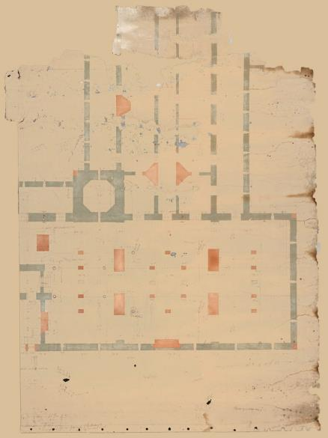
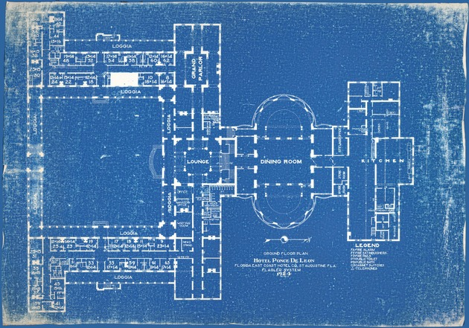
Notes:
Hotel Ponce de Leon

Slide 10
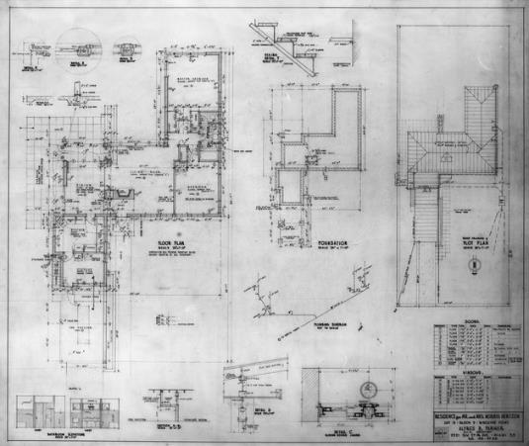
Typical series
Project Records
Personal Papers
Professional Papers
Office Records
Faculty Papers
Artifacts, Art
Notes:
Parker working drawing

Slide 11
Description
use the Art & Architecture Thesaurus (AAT) to identify/describe
rely on project lists
project records: arrangement and description often do not match
Notes:
Parker – Royal Road

Slide 12
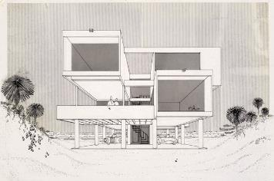
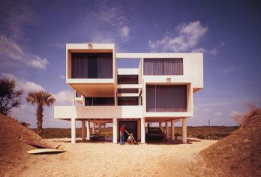
Project records
drawings, photos, project files, etc.
could group all records for single project together
or, could sort like materials physically
describe by project (particularly since researchers often come looking for specific projects)
Notes:
Morgan - Goodloe

Slide 13
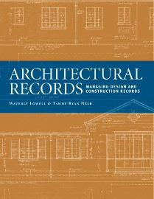
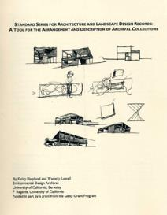
Keep these close
Architectural Records: Managing Design and Construction Records, by Waverly B. Lowell and Tawny Ryan Nelb, 2006
Standard Series for Architecture and Landscape Design Records: A Tool for the Arrangement and Description of Archival Collections by Waverly Lowell and Kelcy Shepherd, 2010
Architectural Photoreproductions: A Manual for Identification and Care, by Eleonore Kissel and Erin Vigneau, 2009

Slide 14
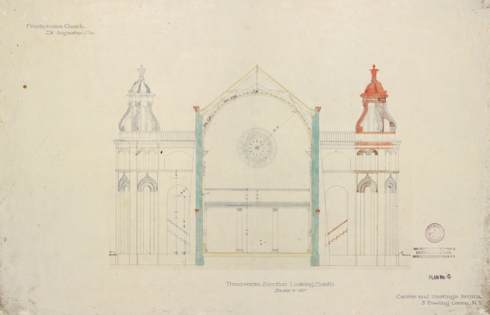
Storage
Buffered vs. unbuffered supports
folders
flat files
rolls – tubes
rolls - boxes
Notes:
Memorial Presbyterian

Slide 15
Interior and exterior tubes
Image source: Verheyen, Davis, & Olson Storage of Architectural Materials at the Syracuse University Library
http://cool.conservation-us.org/coolaic/sg/bpg/annual/v22/bp22-25.pdf

Slide 16
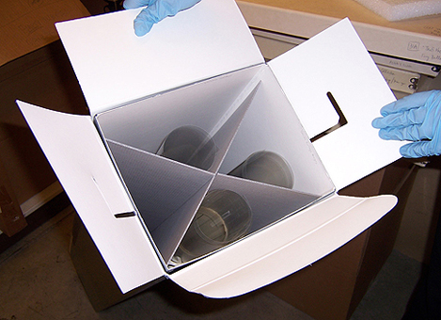
Telescoping roll box with x-shaped supports

Slide 17
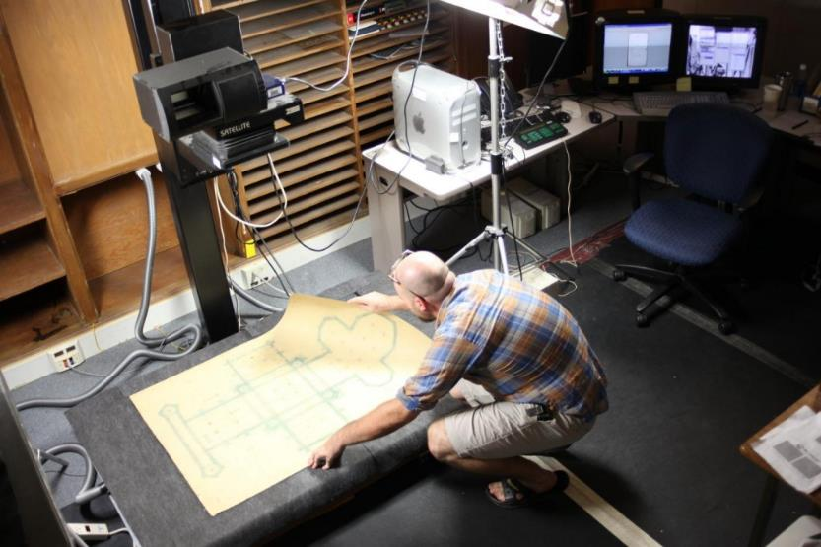
Digitization

Slide 18
Conservation

Slide 19
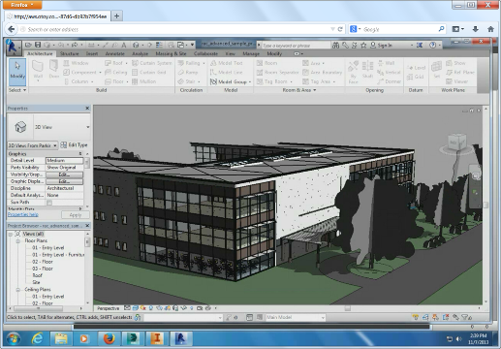
Digital records
AutoCAD, rendering software
physical media
migration
normalization
emulation
etc.

Slide 20
Thanks!
John Nemmers
Head of Collection Services; Associate Chair
Special & Area Studies Collections
University of Florida
jnemmers@ufl.edu
352-273-2766

