Slide 1
“Jesse S. Wooley’s Florida Photographs” at the University of Miami Richter Library
Society of Florida Archivist 2015 Annual Meeting Miami, Florida

Slide 2
Jesse Sumner Wooly (1867 – 1943)
From Ballston Spa, NY
Left school at 13 to become a photographer’s apprentice
He bought out his employer, T.J. Arnold, in 1887
He joined Seneca Ray Stoddard 1893 in a trek through the Adirondacks to photograph
His first trip to Florida was in 1896
He began traveling to Florida by car in 1923
He and his wife, Susy, had two children; a daughter and a son

Slide 3
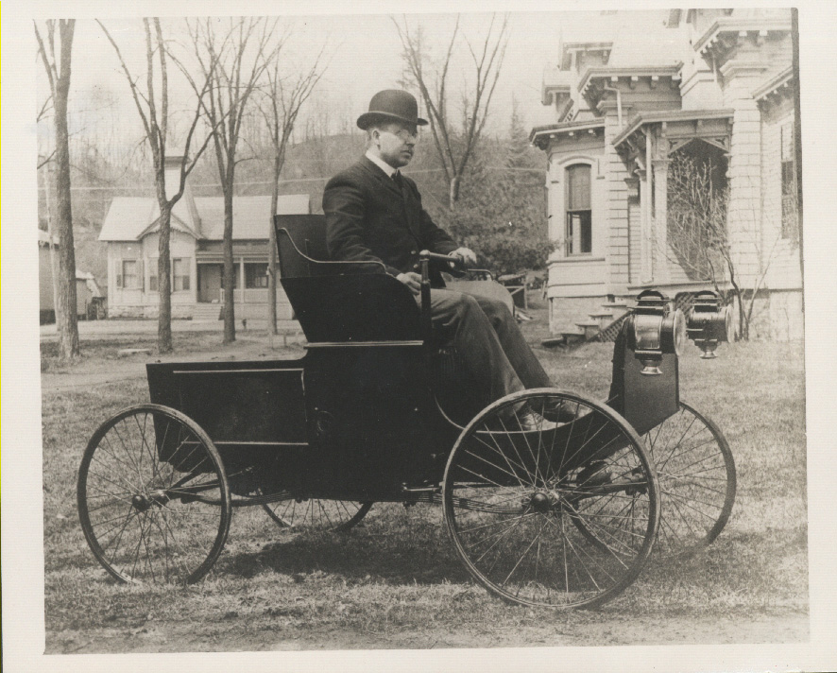

Slide 4
The Dixie Highway and Carl Fisher

Slide 5
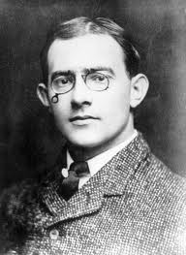
Carl Fisher (1874-1939)
Indianapolis Speedway
Lincoln Highway
Dixie Highway
Miami Beach
Never a dull moment with Carl

Slide 6
Dixie Highway in Florida

Slide 7
Entering Florida

Slide 8
Dixie Highway - 1928 The Savannah-Jacksonville Road

Slide 9
Suwannee River - 1927

Slide 10
Welcome to Florida - 1929

Slide 11
Med Fly Inspection - 1929

Slide 12
The Adventure Begins -1923

Slide 13
Jacksonville

Slide 14
Jacksonville Skyline - 1929

Slide 15
Busy City Street – 1926

Slide 16
Hotel Royal Palms - 1929

Slide 17
Drive Along the St. Johns - 1926

Slide 18
St. Augustine

Slide 19
Juan Ponce de Leon - 1930

Slide 20
Fountain of Youth - 1923

Slide 21
Garnet Orange Grove- 1923

Slide 22
A Trot Around Town – 1930

Slide 23
The Oldest House – 1929

Slide 24
The Oldest House – 1930

Slide 25
Ponce de Leon Celebration – 1930

Slide 26
Juan Ponce de Leon – 1930

Slide 27
Four Nations -1930

Slide 28
Daytona Beach & Surrounding Areas

Slide 29
Mary McLeod Bethune – 1930

Slide 30
Jump – 1930

Slide 31
Hot Dog Doggies on the Beach – 1930

Slide 32
Live Oak Trees, New Smyrna - 1928

Slide 33
Banks of the Indian River - 1928

Slide 34
Dixie Highway – 1929

Slide 35
Traveling East to West and West to East

Slide 36
Kingdom of the Sun – 1929

Slide 37
Packing Plant, Lake Alfred – 1929

Slide 38
Two Lane Blacktop – 1928

Slide 39
Heading to East Florida – 1928

Slide 40
Orange Groves – 1927

Slide 41
Orlando

Slide 42
The Buick Nearing Orlando - 1925

Slide 43
Orlando – 1925

Slide 44
Lake Eola – 1930

Slide 45
Tampa

Slide 46
West Dixie Highway – 1923

Slide 47
Gandy Bridge – 1929

Slide 48
Christmas with the Kennedys - 1929

Slide 49
On the Hillsborough River - 1930

Slide 50
Tampa Bay Hotel – 1935

Slide 51
Sarasota

Slide 52
Sarasota Bay – 1929

Slide 53
Courtyard Gardens – 1930

Slide 54
Zebras - 1935

Slide 55
Clark Valentine’s Place in Palmetto – 1928

Slide 56
St. Petersburg

Slide 57
Busy Downtown - 1929

Slide 58
Stewart Rooming House - 1929

Slide 59
Sunshine Card Club - 1928

Slide 60
Sunshine Parade - 1927

Slide 61
Beauty Contest – 1927

Slide 62
Hotel Rolyat – 1928

Slide 63
Central Avenue – 1930

Slide 64
At Church – 1932

Slide 65
Parade on Central Avenue – 1935

Slide 66
St. Pete Neighborhood – 1935

Slide 67
Princess Martha Hotel – 1935

Slide 68
Pass-a-Grille Beach – 1928

Slide 69
Don CeSar Hotel - 1929

Slide 70
Picnic at the Beach - 1930

Slide 71
Christmas Day – 1933

Slide 72
Marion Wooley at Clearwater Beach - 1935

Slide 73
Palm Beach West Palm and Lake Worth

Slide 74
The Breakers – 1926

Slide 75
At the Beach – 1923

Slide 76
The Buick – 1924

Slide 77
Susie Wooley – 1928

Slide 78
Palm Beach Workers at Home – 1925

Slide 79
Sugar Cane Field - 1929

Slide 80
Lake Worth - 1928

Slide 81
Lake Worth - 1928

Slide 82
Miami and Miami Beach

Slide 83
Miami Skyline & Biscayne Bay - 1928

Slide 84
Biscayne Bay – 1923

Slide 85
Lyndonia – 1924

Slide 86
Bayfront Park - 1930

Slide 87
Bayfront Park - 1927

Slide 88
Causeway to Miami Beach – 1930

Slide 89
Third Street – 1934

Slide 90
FDR Visits Miami - 1934

Slide 91
Used Car Lot - 1934

Slide 92
Brickell Avenue – 1929

Slide 93
High-wire Act – 1928

Slide 94
Joe Powers – 1928

Slide 95
Biltmore Hotel – 1927

Slide 96
"Minarets" in Opa-Locka - 1926

Slide 97
Administration Building -1925

Slide 98
Miami Battle Creek Sanitarium – 1930

Slide 99
Adirondack-Florida School - 1931

Slide 100
Palm Garden – 1933

Slide 101
Roberts Grove – 1933

Slide 102
Hialeah Park - 1929

Slide 103
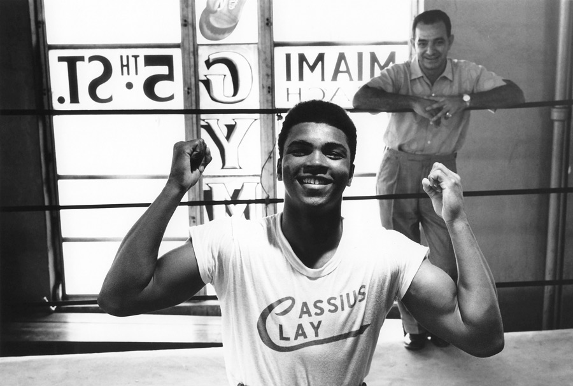

Slide 104
Boxing in Miami – 1927

Slide 105
Venetian Pool

Slide 106
Father and Child - 1929

Slide 107
Mother and Children – 1929

Slide 108
Alligator Wrestler – 1929

Slide 109
“Caribbean Clipper" – 1931

Slide 110
Palm Fete Parade – 1928

Slide 111
"City of New York" – 1931

Slide 112
"Seth Parker" - 1934

Slide 113
Gunboat "Cuba" – 1934

Slide 114
Miami Skyline – 1934

Slide 115
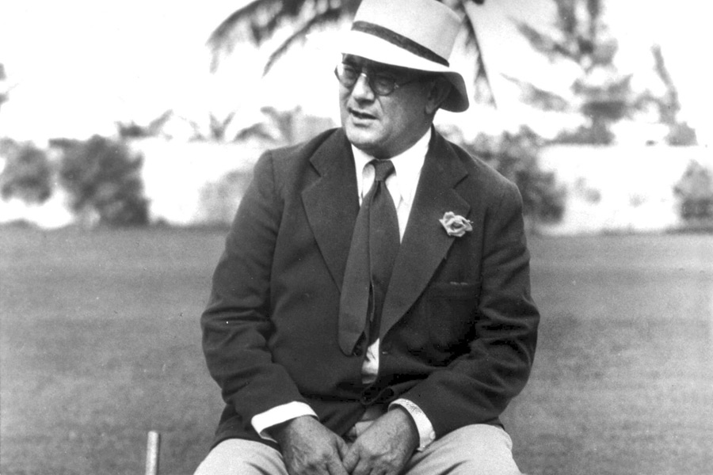
Mr. Miami Beach

Slide 116
Hotel Flamingo – 1923

Slide 117
Calisthenics at the Beach – 1924

Slide 118
Miami Beach – 1933

Slide 119
Roney Plaza – 1928

Slide 120
Easter Sunday – 1934

Slide 121
Fishing Early 20th Century

Slide 122
Hammerhead Shark – 1923

Slide 123
Sailfish – 1928

Slide 124
Giant Manta Ray – 1929

Slide 125
Caught on the “Pal”

Slide 126
Fishing Today - 2015

Slide 127
The Keys

Slide 128
Overseas Railroad – 1930

Slide 129
7 Mile Bridge – 1930

Slide 130
In the Keys – 1930 with Nellie Cross and Mr. and Mrs. Bosworth

Slide 131
Key West – 1930

Slide 132
Southern Most Point – 1932

