Slide 1
Still Stickin’ Around: Polk County Citrus Label Tour
LuAnn Mims, Special Collections Librarian
City of Lakeland Public Library
Society of Florida Archivists ~ May 2017
Notes:
Introduction and my context
If you are an archivist or special collections librarian in Florida you have handled or had stewardship over a CITRUS crate label collection – Right?!

Slide 2
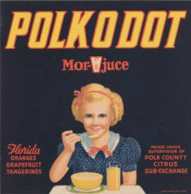
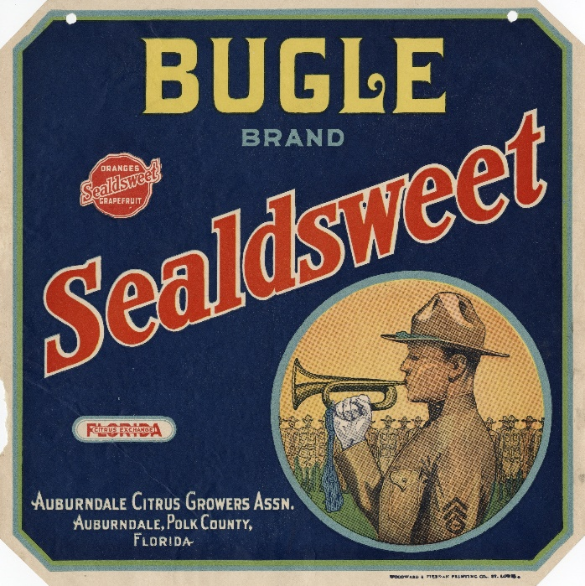
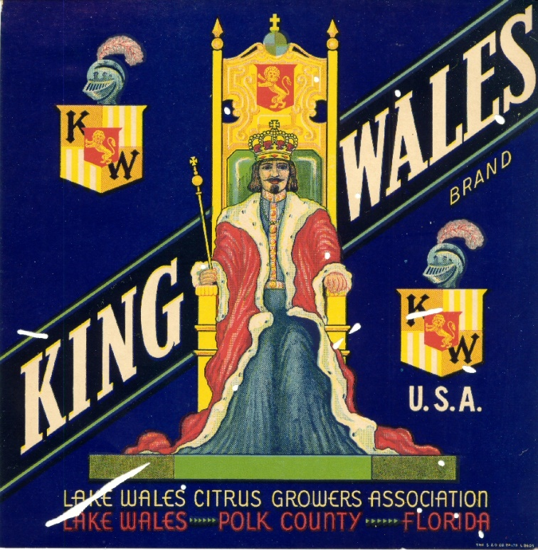
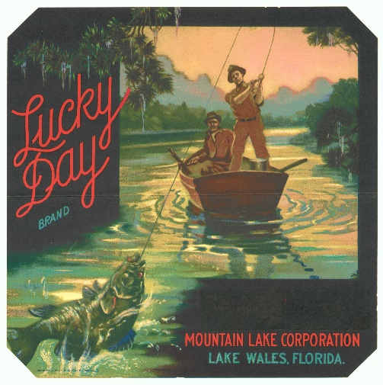
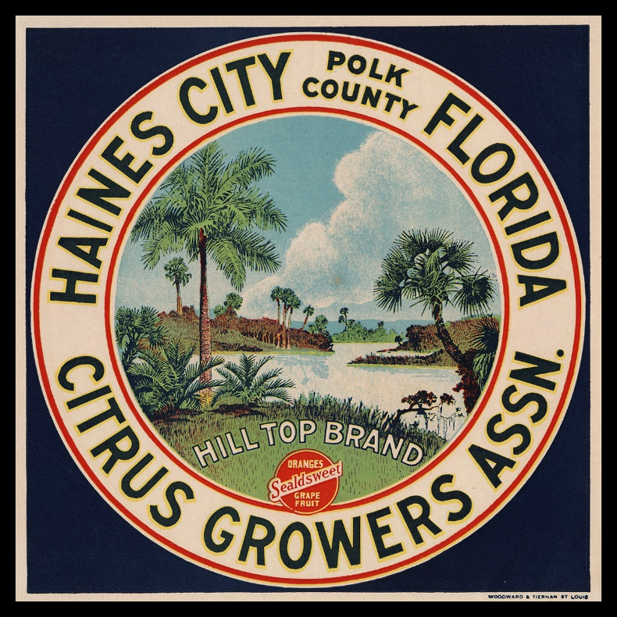
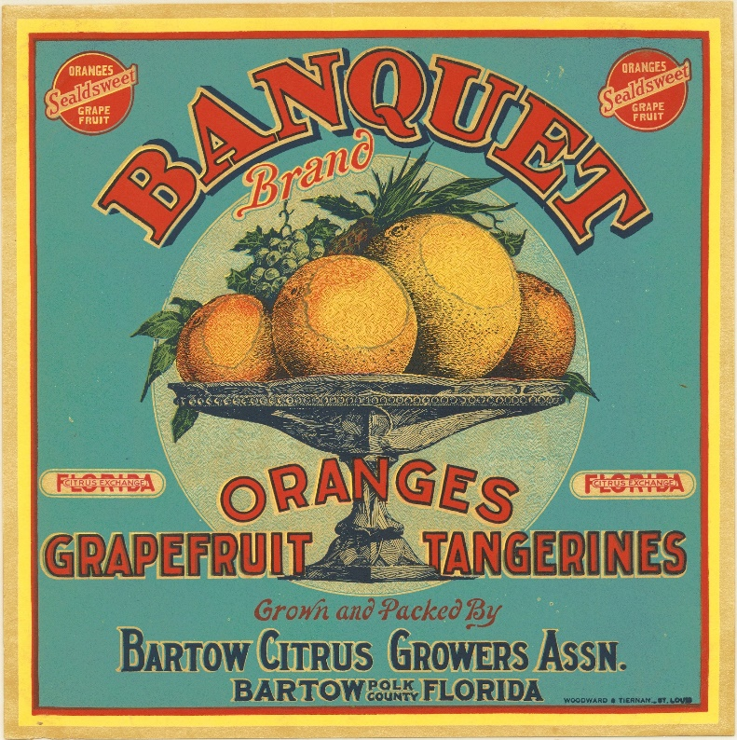
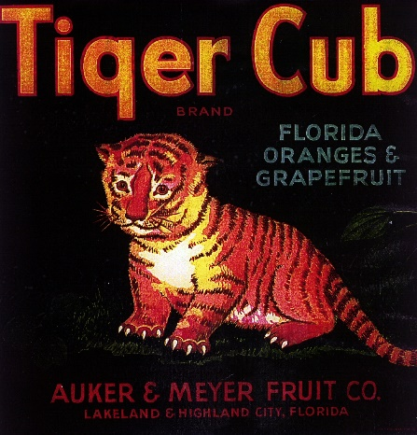
Notes:
These beautiful labels – utilitarian during the peak or their use – and now sought after as collectible pieces of art. They represent the golden age of fresh fruit shipping in Florida.
National printers with staff artists worked with local packinghouses to design custom labels to represent their brands – early branding but also served as advertisement for not only the citrus – but also the state of Florida
The buyer in the northern market would be drawn to the colorful labels during the dreary winter months and see the beautiful warm environment – rich with wildlife, flowers, trees and scantily clad women!

Slide 3
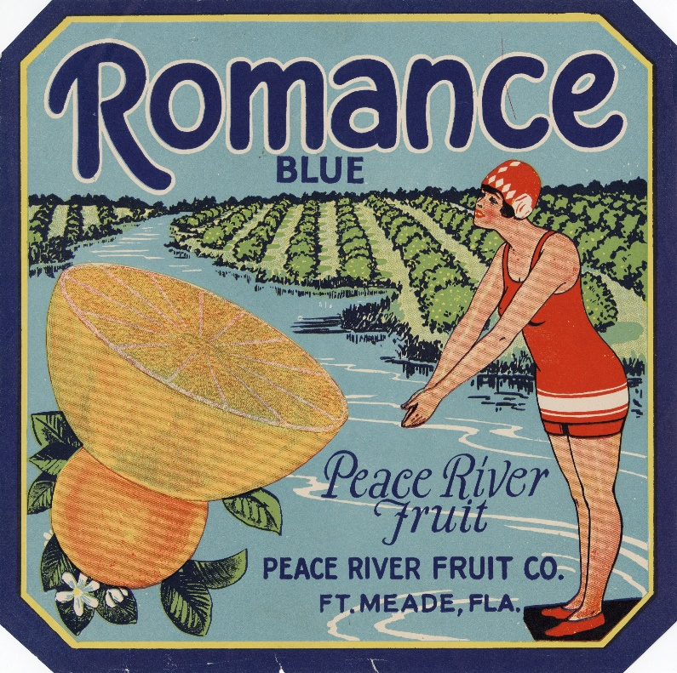
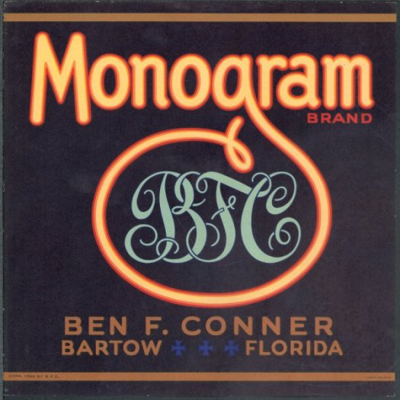
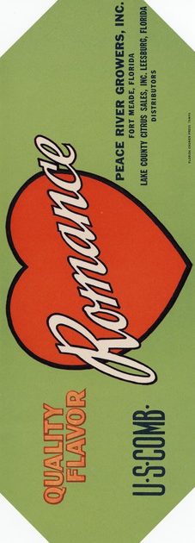
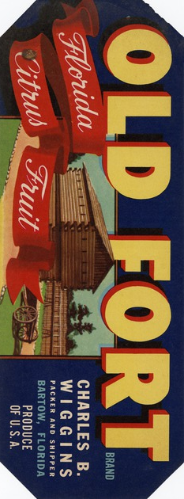
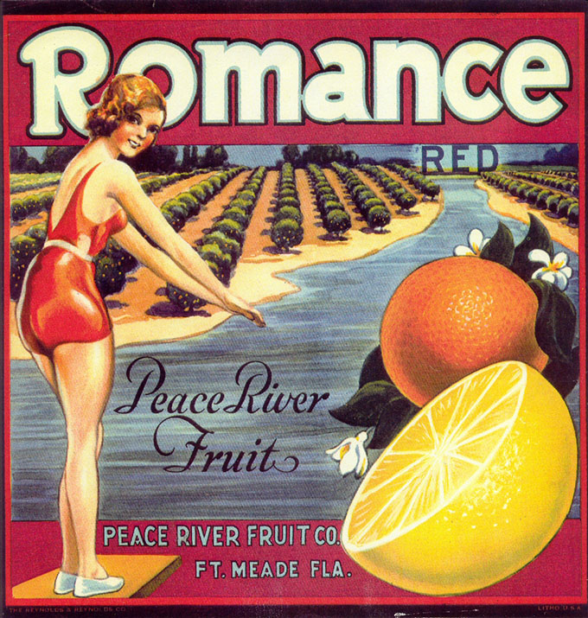
Notes:
The story the label tells is of the quality of the fruit held within that was registered with the Florida Citrus Commission when they began in 1935.
Blue labels denoted grade 1 fruit – high quality
Red labels meant a combination of fruit – partially lower grade mixed with second round higher grades
Yellow – juicy fruit inside – but the peel might be blemished
Black was used for the exchanges – cooperatives that shipped the fruit under a singular label
A few other colors – like green or brown were reserved for specialty fruits

Slide 4
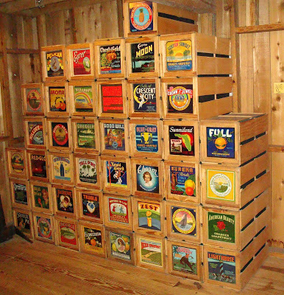
Notes:
These 9 inch by 9 inch paper labels were adhered to the end of a wooden crate – imagine a wall of these in a warehouse – they buyer would know the brand they wanted just by seeing the label.
Some labels are smaller 9 x 3/5 inches – placed on the diagonal of the crate end – or used on smaller shipping crates
Never the less – they were throw away items –ephemera – especially after WWII whne wood and metal were harder to get – the industry changed to the corrugated box – which was not only lighter, but sturdy and branding could be printed directly on the medium

Slide 5
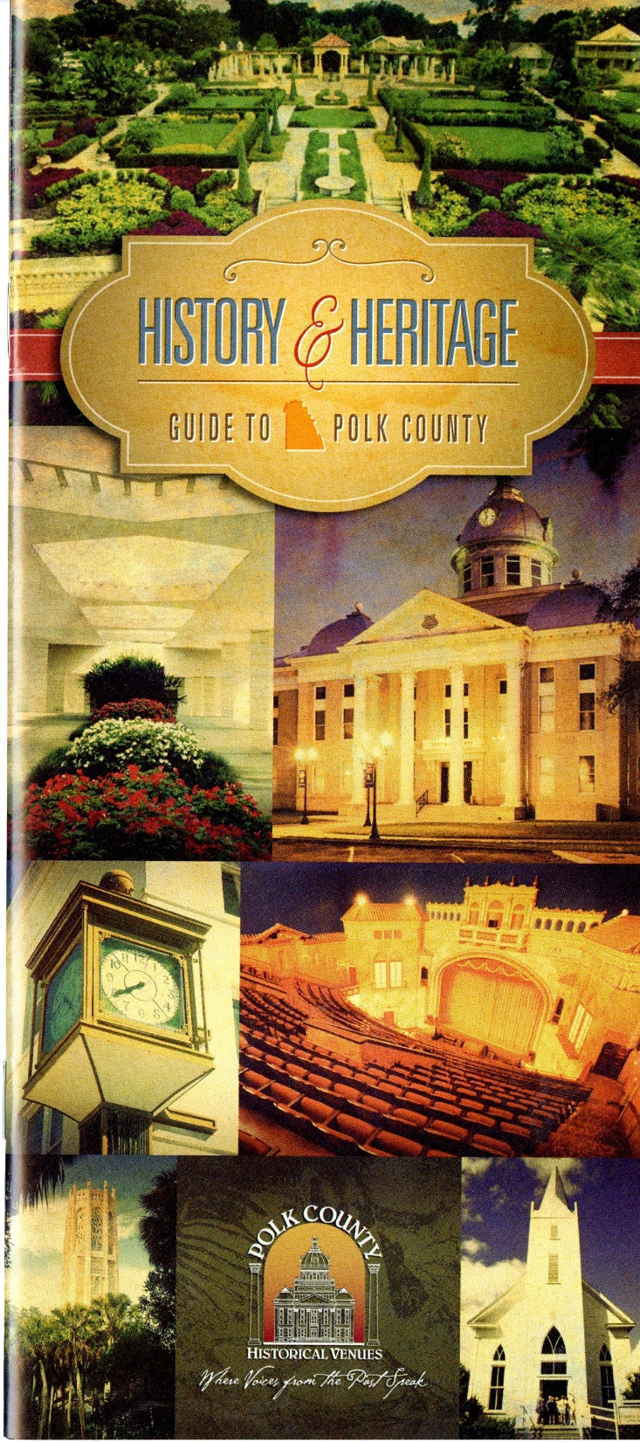
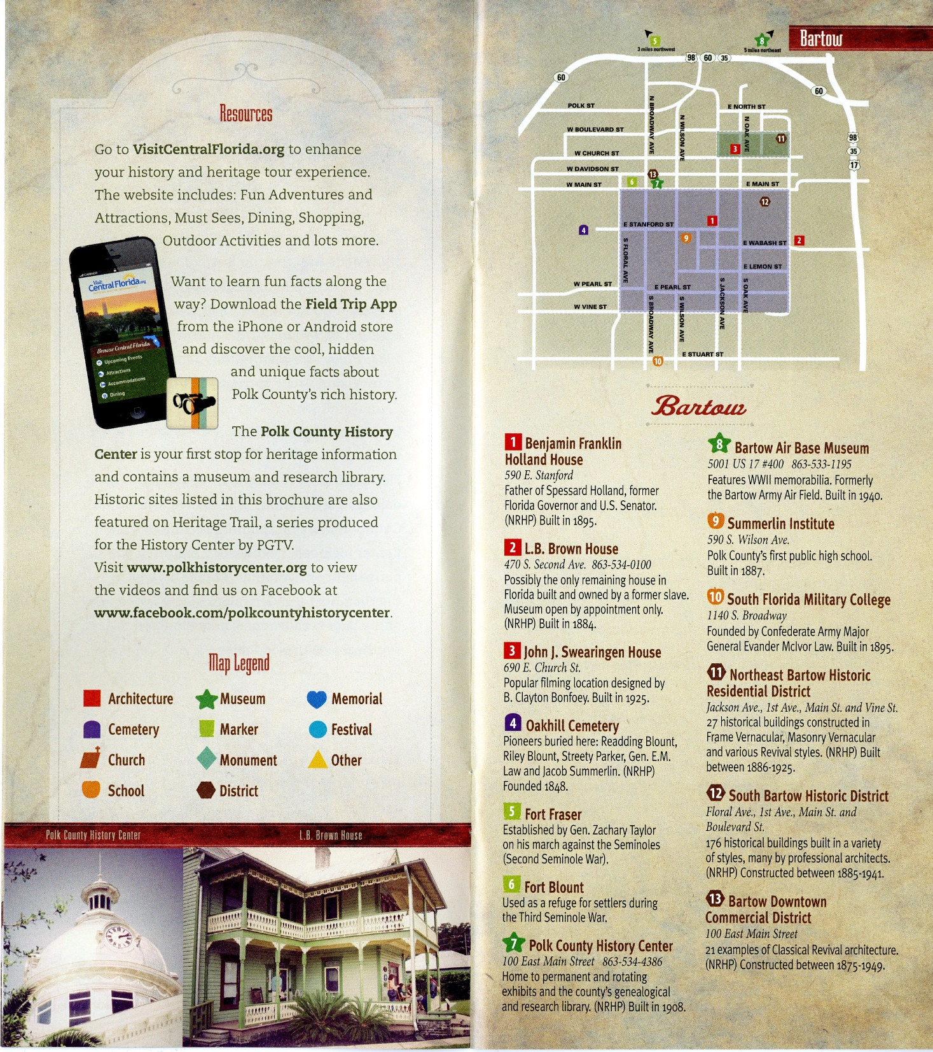
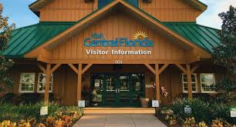
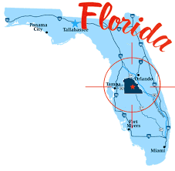
Notes:
There are many ways to promote collections – the public loves seeing crate labels
In Polk County – a group called the History and Heritage Forum – founded grassroots efforts to identify and enumerate local heritage sites, museums, walking tours, historic markers, etc in ALL the municipalities of the county – very large geographic area
The data collected produced a brochure and website with the Visit Central Florida group who had obtained a grant to promote local history – this 28 page brochure – now going on a second round of printing has been successful in marketing lesser traveled areas and creating PRIDE of PLACE for locals

Slide 6
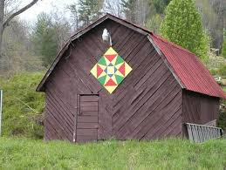
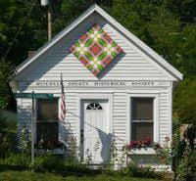
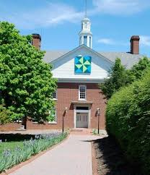
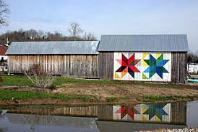
Notes:
This process has been going on for about five years – but a couple of years ago a member of the Forum mentioned her travels to North Carolina where she enjoyed following the local quilt heritage trail which was marked with enlarged quilt blocks which adorned sides of barns and other public buildings. She thought it would be a nice addition to do something like that here in Florida.

Slide 7
Notes:
The Forum along with the Polk County History Center, Visit Central Florida decided to partner with the Florida Citrus Hall of Fame to create a Citrus Label tour to reflect our rich citrus heritage – much like a specialty trail focused on WWII or African American heritage.
This tour would be come a driving tour in which every community could have an iconic label representing their contribution to the citrus industry. A committee was formed to navigate the process – which included creating unifying logo – required of all participants as well as establishing a relationship with a graphics company that would reproduce all of the labels keeping a high level of presentation blended with historical context.
All of the fabrication expenses would be borne by applicants so a variety of pricing choices were offered – between $2500 and $250 for banners
Criteria for applicants also required: use of only POLK COUNTY labels (singular exception), the location must have some relevance to the citrus industry, copyright authority would be obtained to use labels in current use
With assistance from Gerri Schaad at FLORIDA Southern College and James Cusick at UF – both of who have large – already digitized citrus label collections – we have been able to procure any label for enlargement

Slide 8
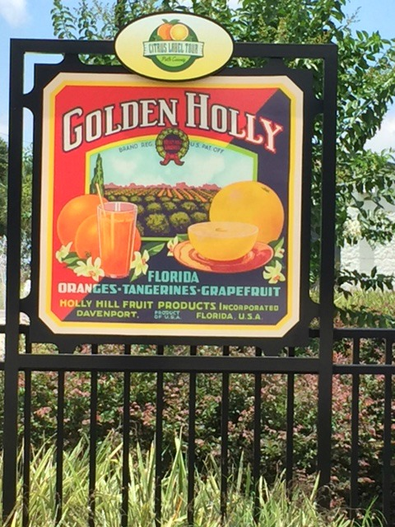
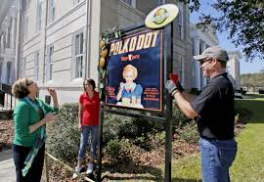
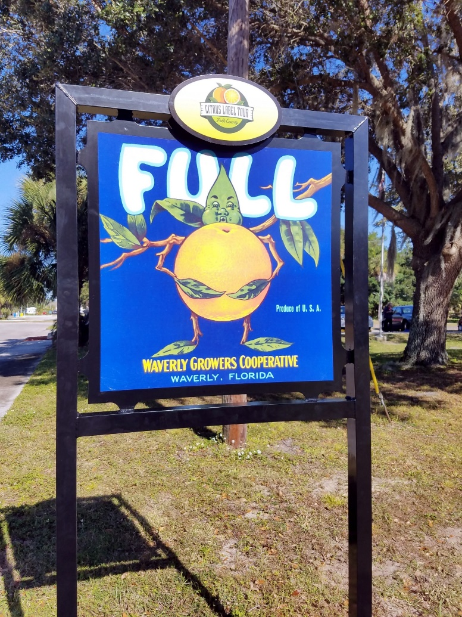
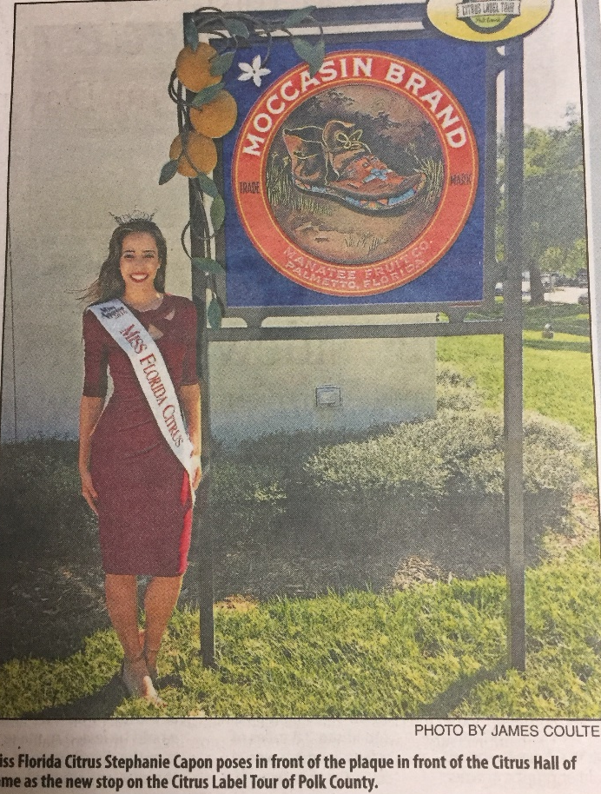
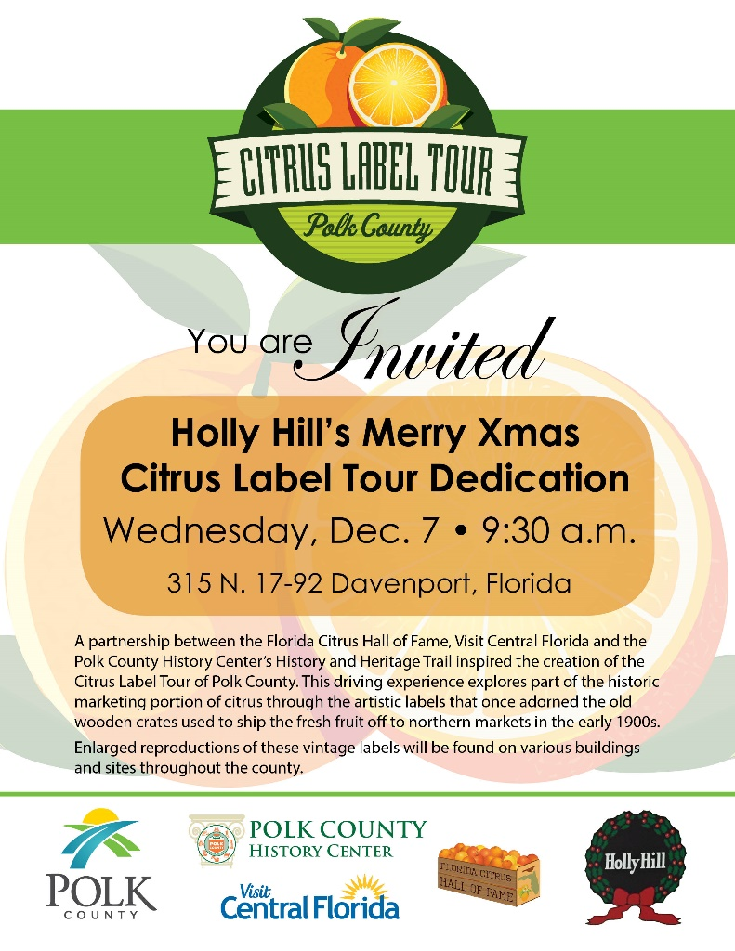
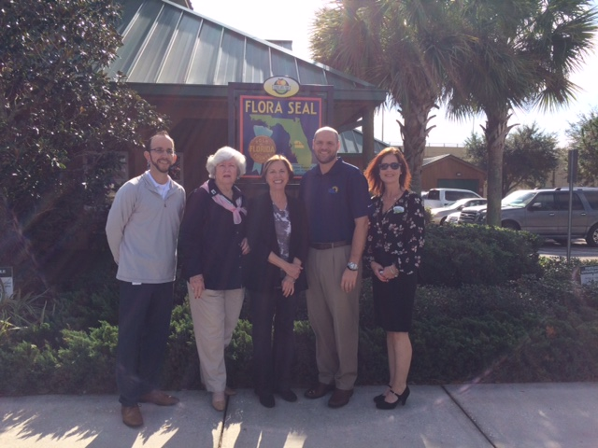
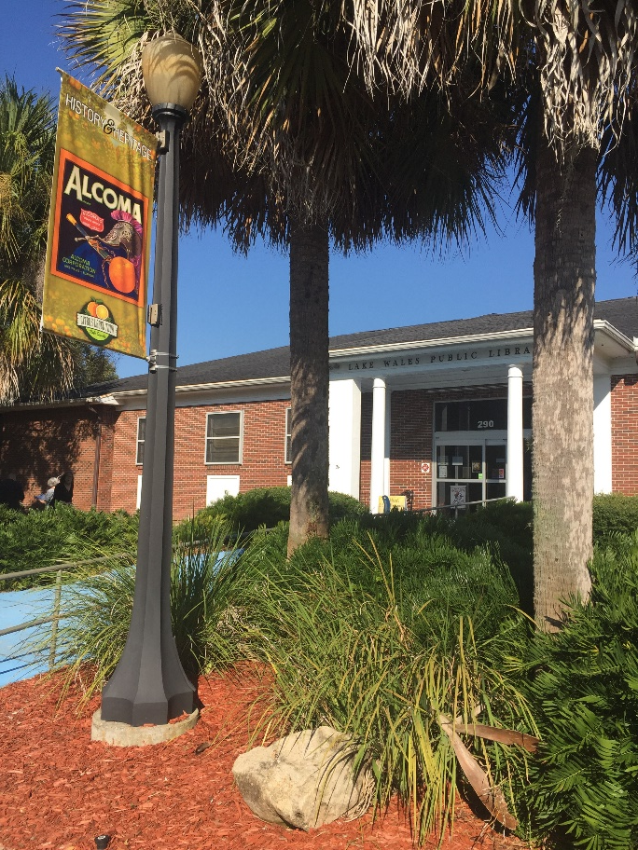
Notes:
The first outdoor art display was dedicated in March 2016 at the Polk County History Center to coincide with the annual induction luncheon of the Florida Citrus Hall of Fame – no interpretation is offered on these displays – the ultimate goal is to produce a driving map with the verbiage included – see next slide

Slide 9
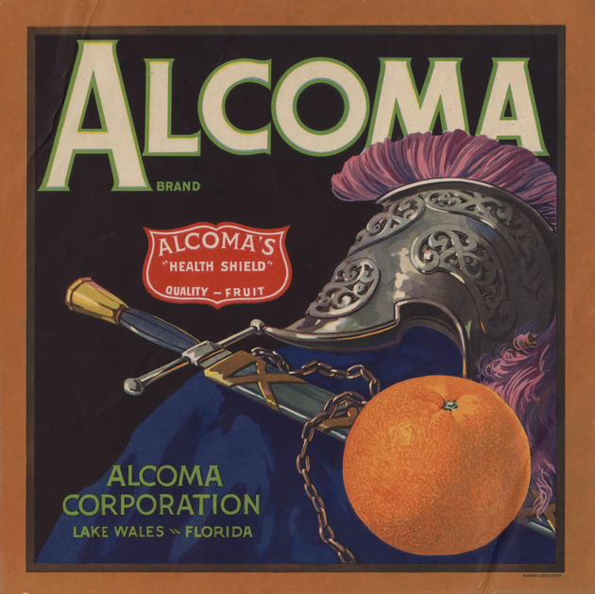
Alcoma
Alcoma Corporation, Lake Wales, FL
Dark background featuring a still-life composition of an orange, centurion helmet and sword
The Alcoma Association was begun by the Updike Family; father Arch and son John in the 1920s. The family owned more than 2400 acres of citrus groves in the Lake Wales area. The Alcoma label was registered in 1932 as grade one fruit. The label design included a seal designating Alcoma’s “Health Shield” quality fruit following the national standard touting Vitamin C to protect health. Both father and son were inducted into the Florida Citrus Hall of Fame in recognition of their contributions to the industry.
The 9 x 9 inch label was affixed on the end of a standard
1 3/5 bushel wooden crate and later on the Bruce wired-bound box, a lighter and stronger alternative.
Schmidt Litho Company, San Francisco, CA, printers.
Notes:
These blurbs will connect the label with the local citrus interests

Slide 10
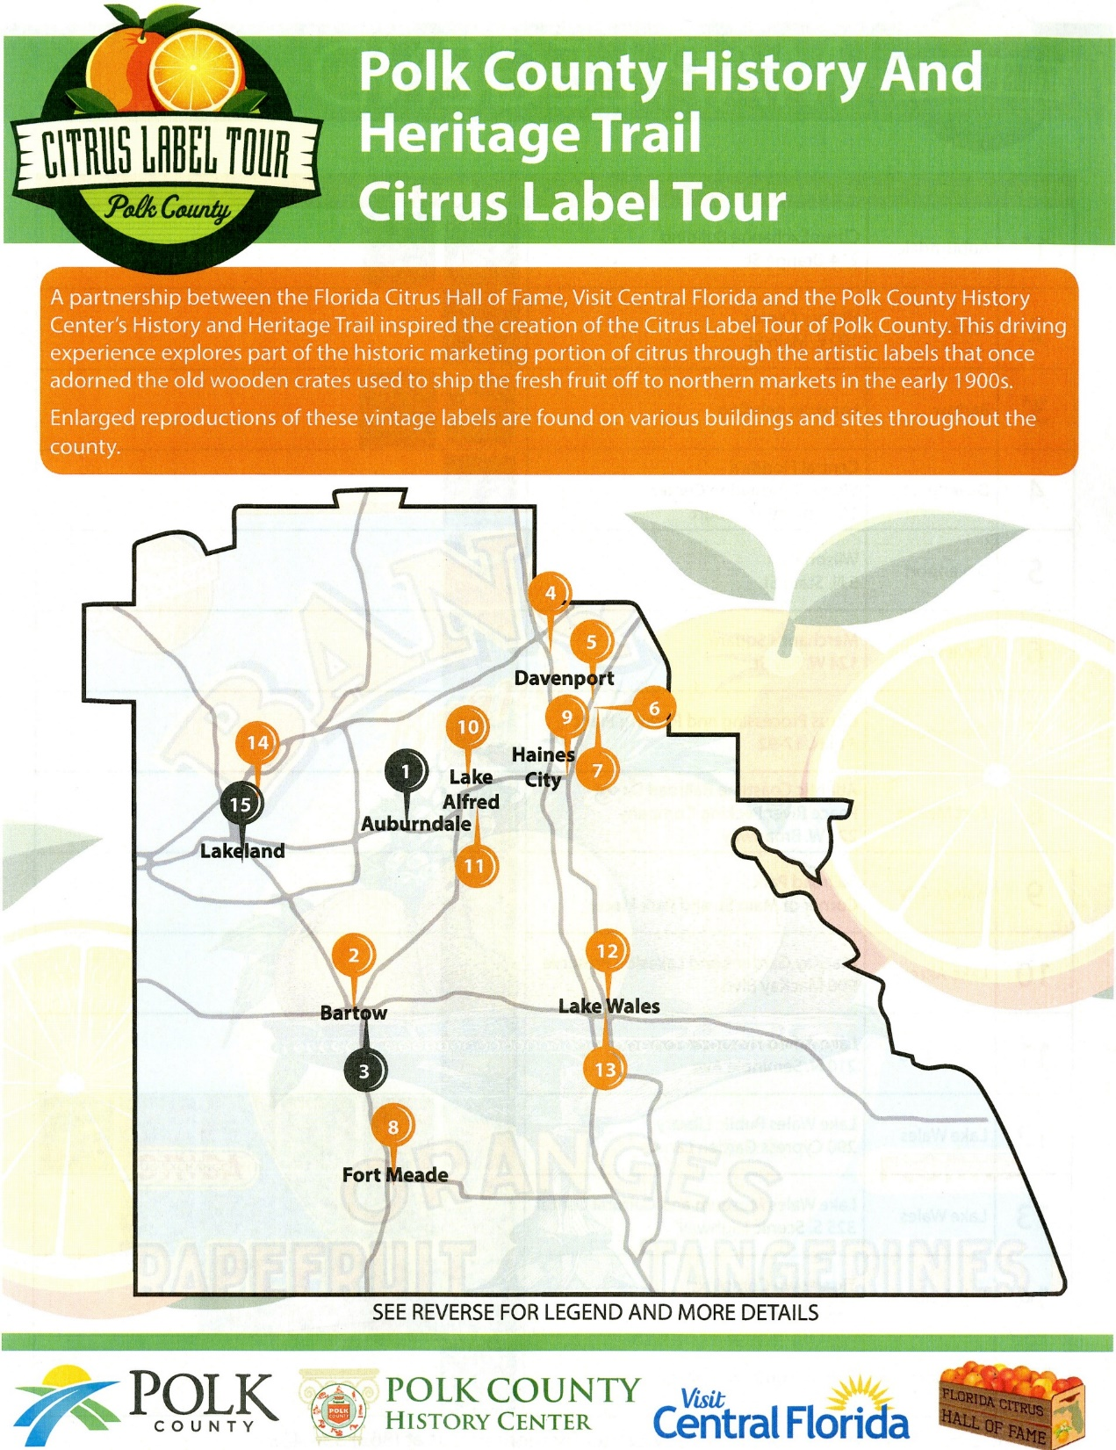
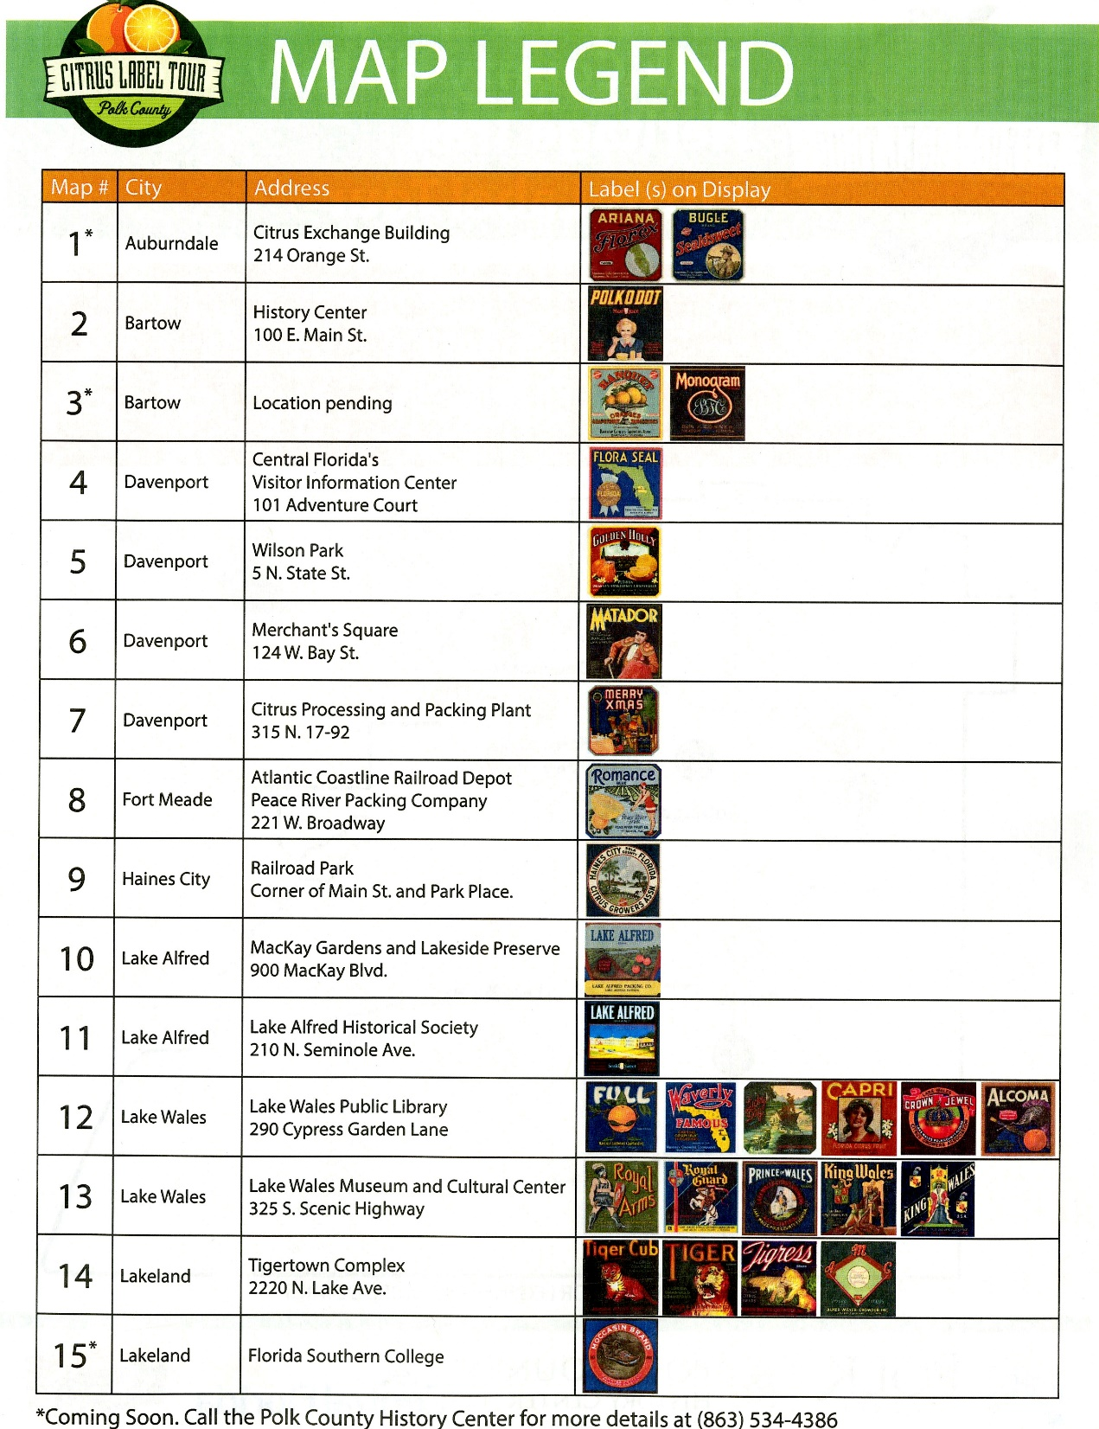
Notes:
To date we have fifteen locations with 29 different labels – only three areas of the county are needed to complete phase one – and these are identified with hopes of finishing before end of summer. In the meanwhile this single sheet of paper serves as a start to the project.
Media coverages and patron responses have been wonderful with inquires from various parts of the state wanting to join the tour – its our hope that each county would do something like this and ultimately form a state trail!
Questions?

